Slide 1
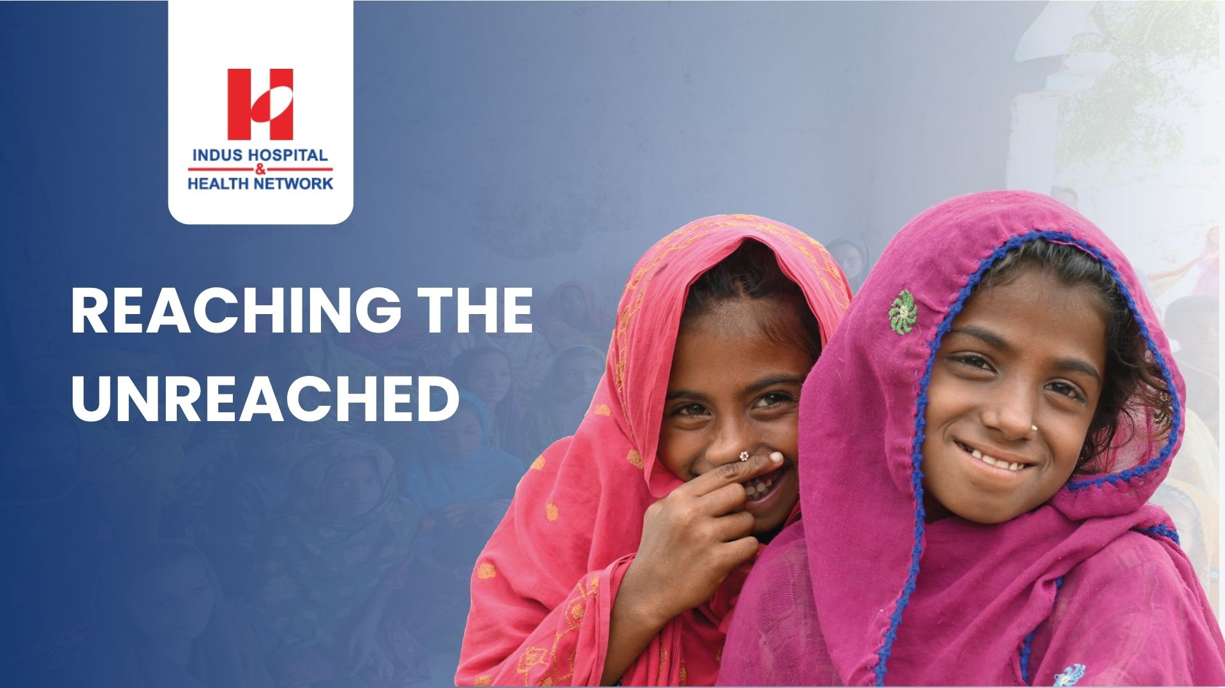
Dr. Maha Talat
Executive Director- IHHN

Slide 2
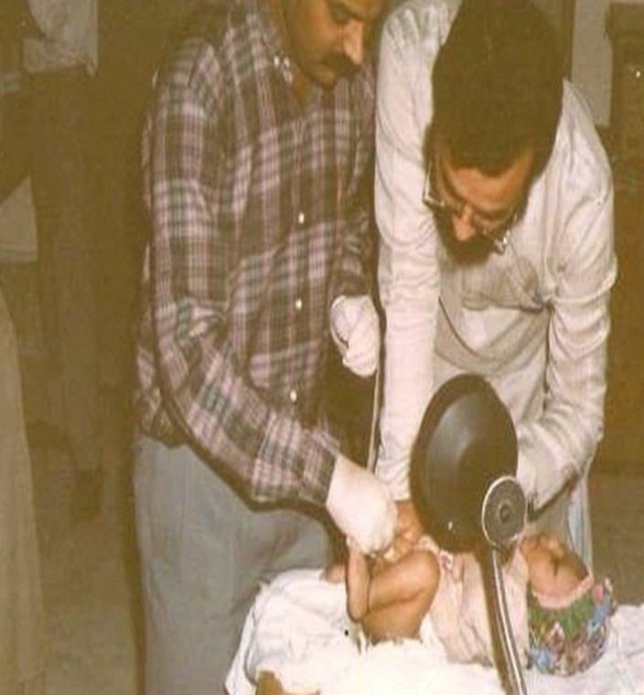
INDUS HOSPITAL & HEALTH NETWORK
Indus Hospital & Health Network (IHHN) was initiated by a group of doctors, businessmen, and philanthropists to provide quality healthcare accessible to all in Pakistan, a country where affordable healthcare is a luxury limited to only a few.
VISION
Create an excellence-driven, comprehensive, compassionate, free-of-charge, replicable healthcare system accessible to all.

Slide 3





UNIQUE FEATURES OF IHHN
In its effort to ensure the accessibility of healthcare, IHHN functions with the following unique features:
Treating 6 million people every year

Slide 4
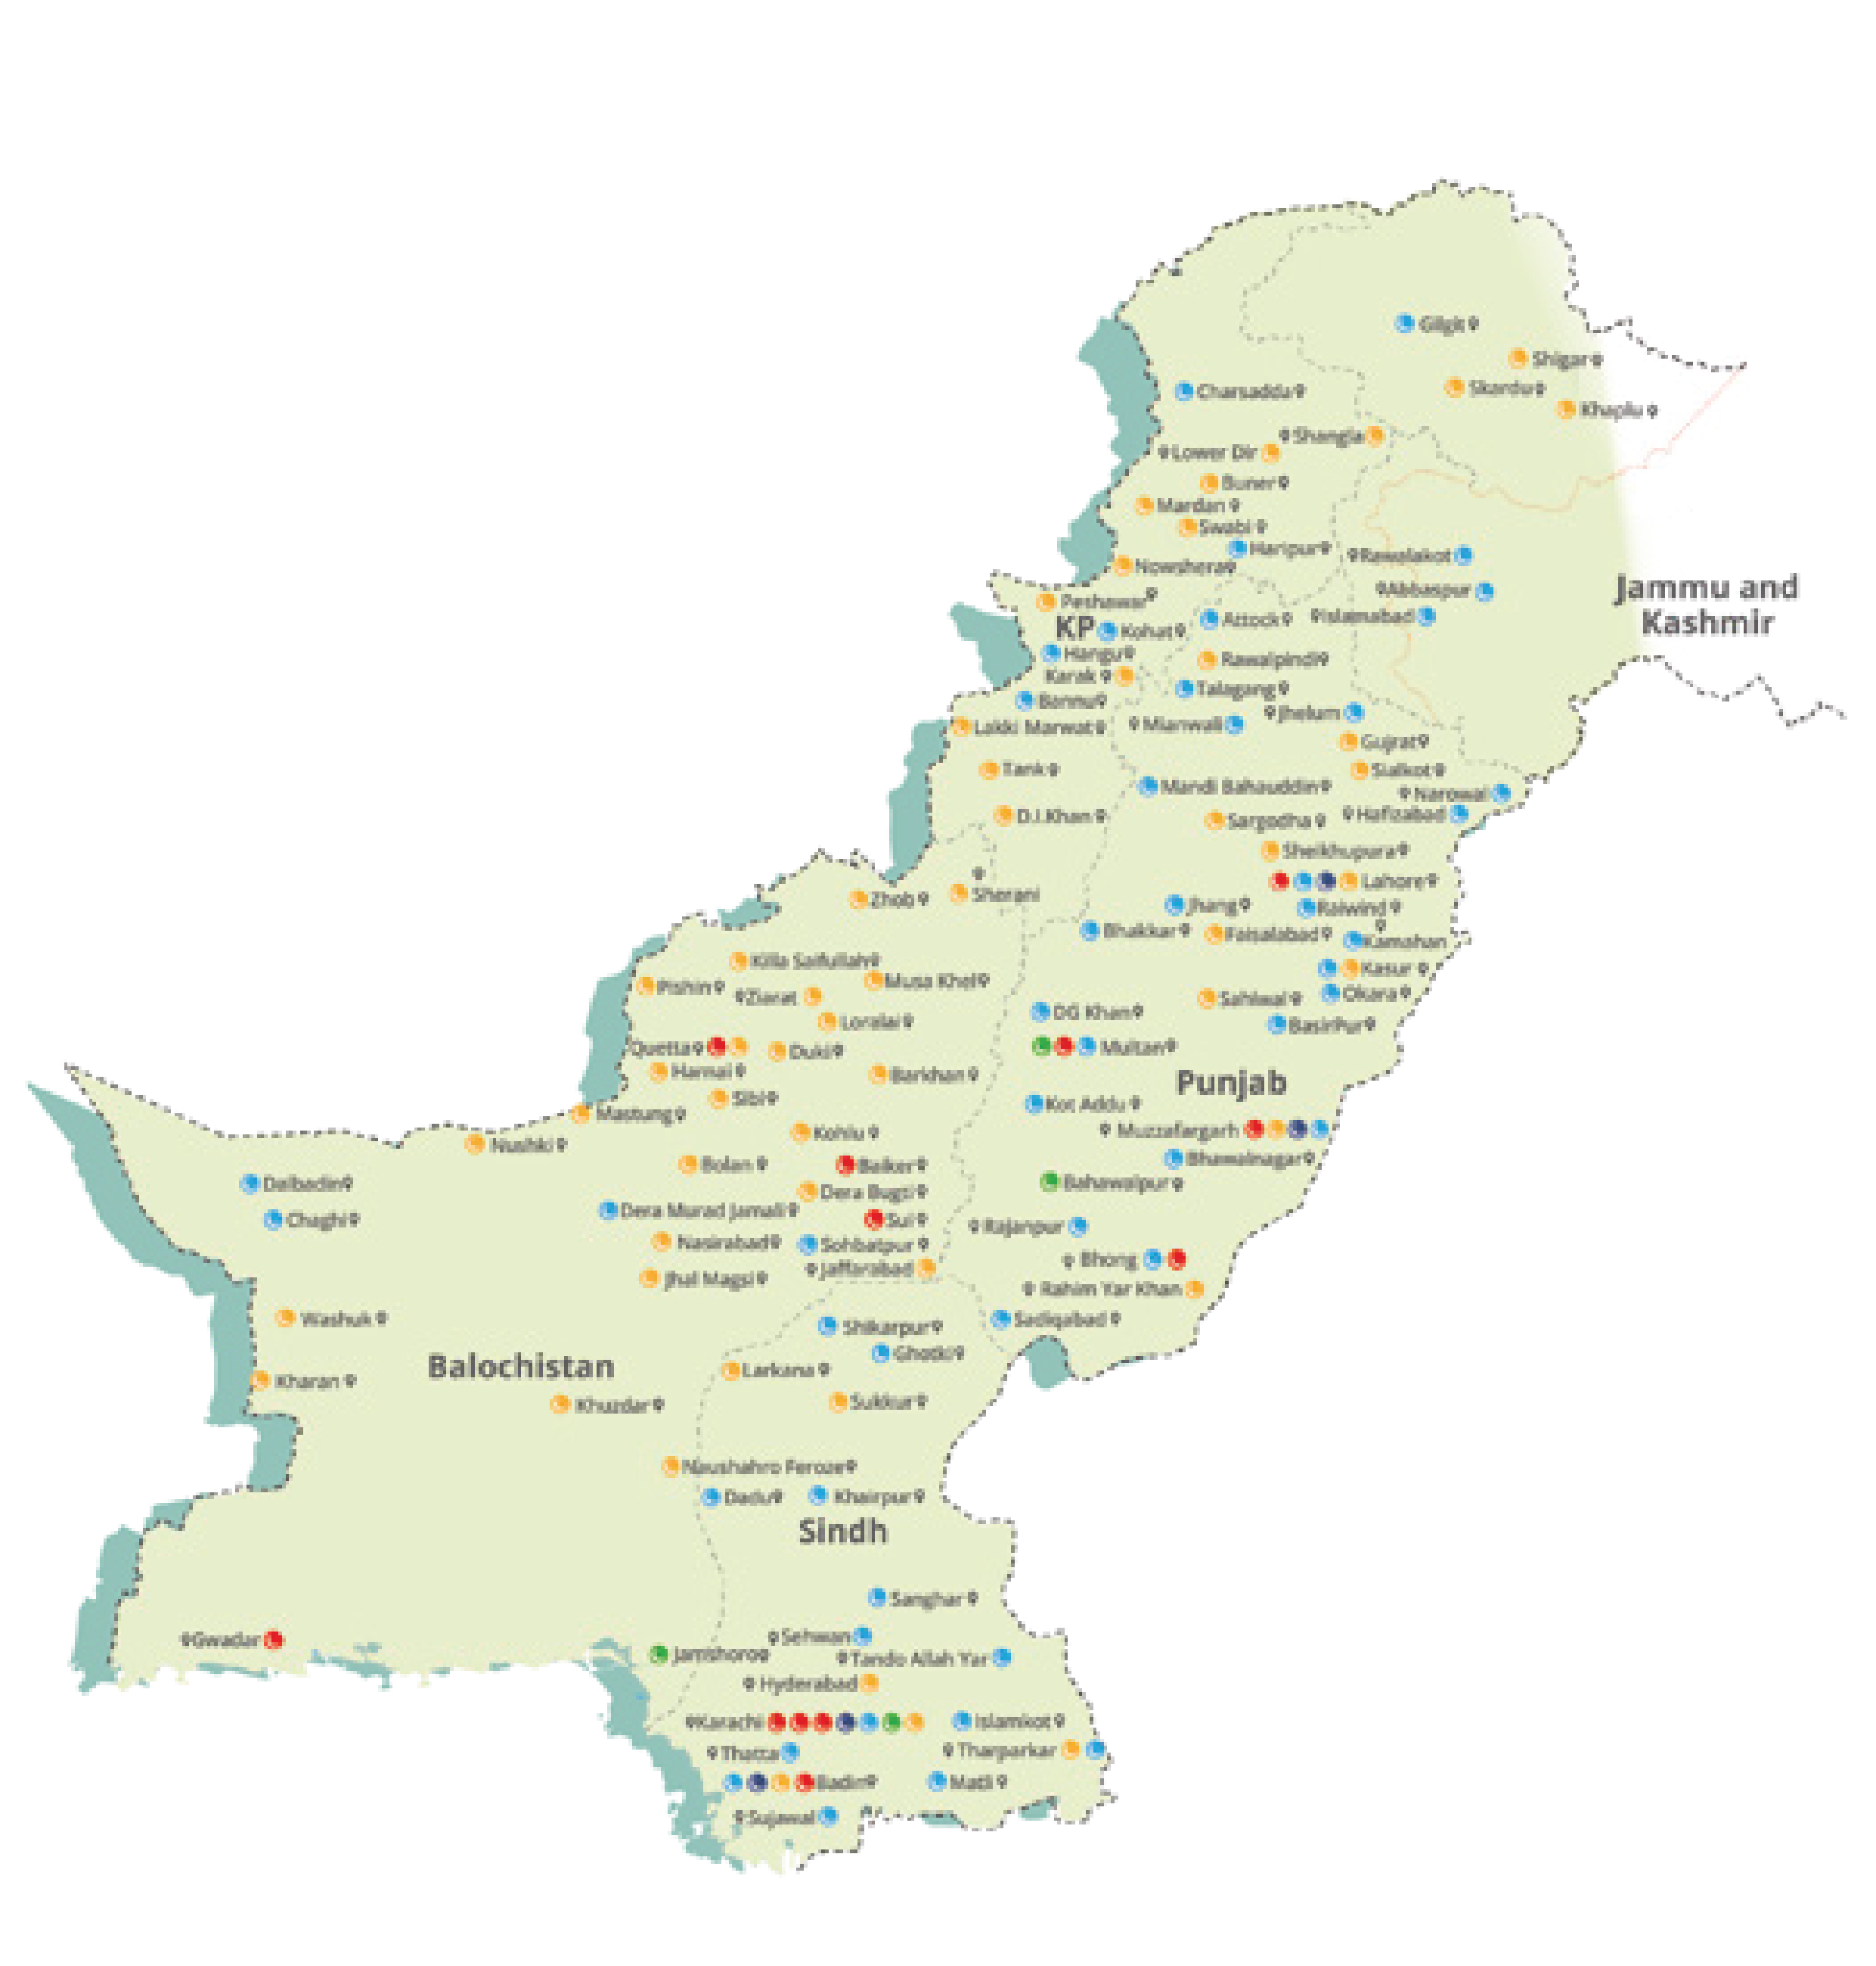
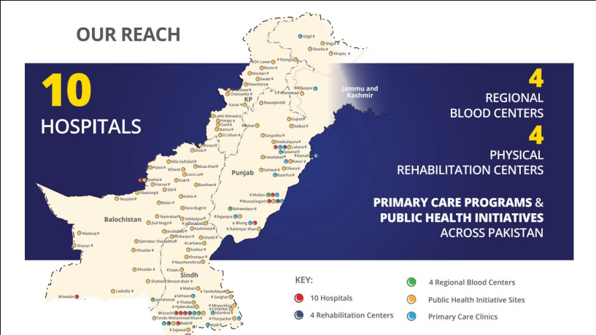
GEOGRAPHIC FOOTPRINT OF INDUS HOSPITAL IN PAKISTAN
13
4
REGIONAL BLOOD CENTERS
HOSPITALS
3
REHABILITATION
CENTERS
100+
PRIMARY CARE PROGRAM &
PUBLIC HEALTH INITIATIVES
ACROSS PAKISTAN
Hospitals
Rehabilitation Centers
Regional Blood Centers
Public Health Initiatives
Primary care clinics

Slide 5

IHHN'S
APPROACH
Integrated Primary Care Access
Service Delivery Through Hospitals
Education & Capacity Building
Research & Development
Multi-Sectoral Approaches
Alliance & Partnerships

Slide 6




IHHN INTERVENTION
Tertiary Care Teaching Hospitals
TERTIARY CARE
Centers of Excellence
Regional Blood Centers Indus Hospital Laboratories
Indus University of Health Sciences
Office of Research, Innovation & Commercialization (ORIC)
Secondary Care Hospitals
SECONDARYCARE
Physical Rehabilitation Centers
Mobile Vans
Community Health Centers
PRIMARY CARE & PUBLIC HEALTH INITIATIVES
Boat
Clinic
Youth Engagement Frontline Health Workers
Pre-Primary Care
Community Engagement

Slide 7
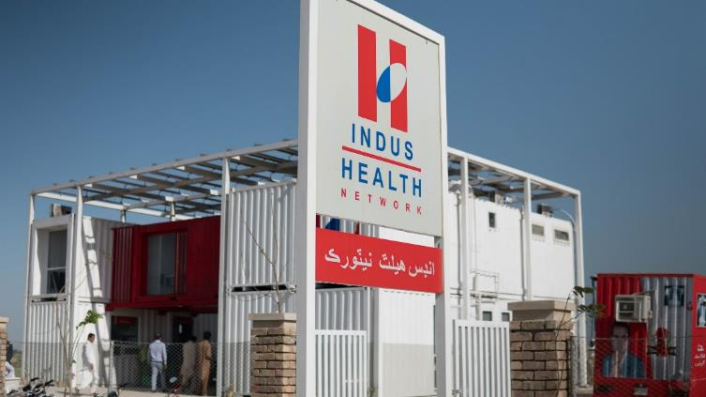
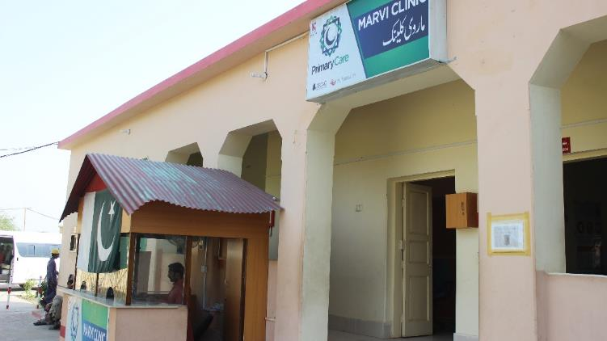

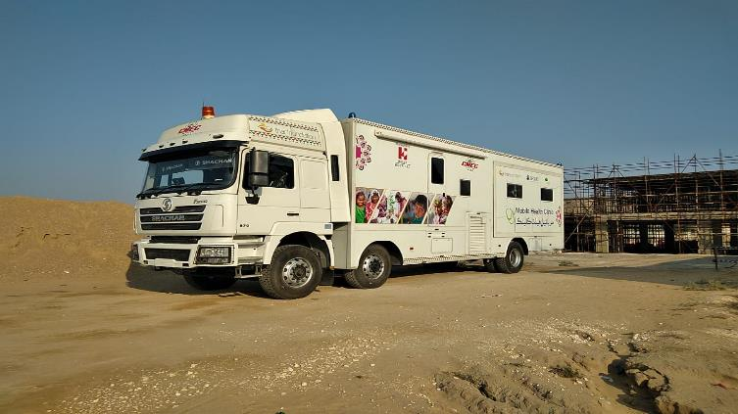
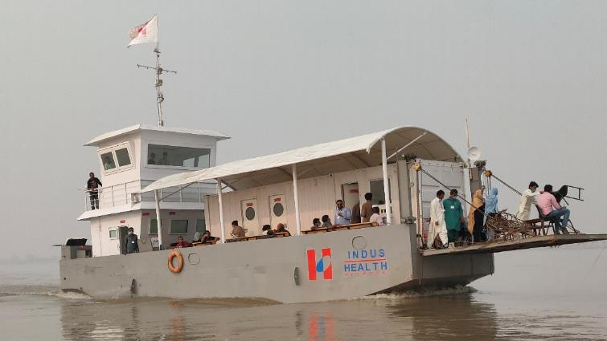
PRIMARY CARE & PUBLIC HEALTH INITIATIVES
for settled and migratory vulnerable populations in remote areas

Slide 8
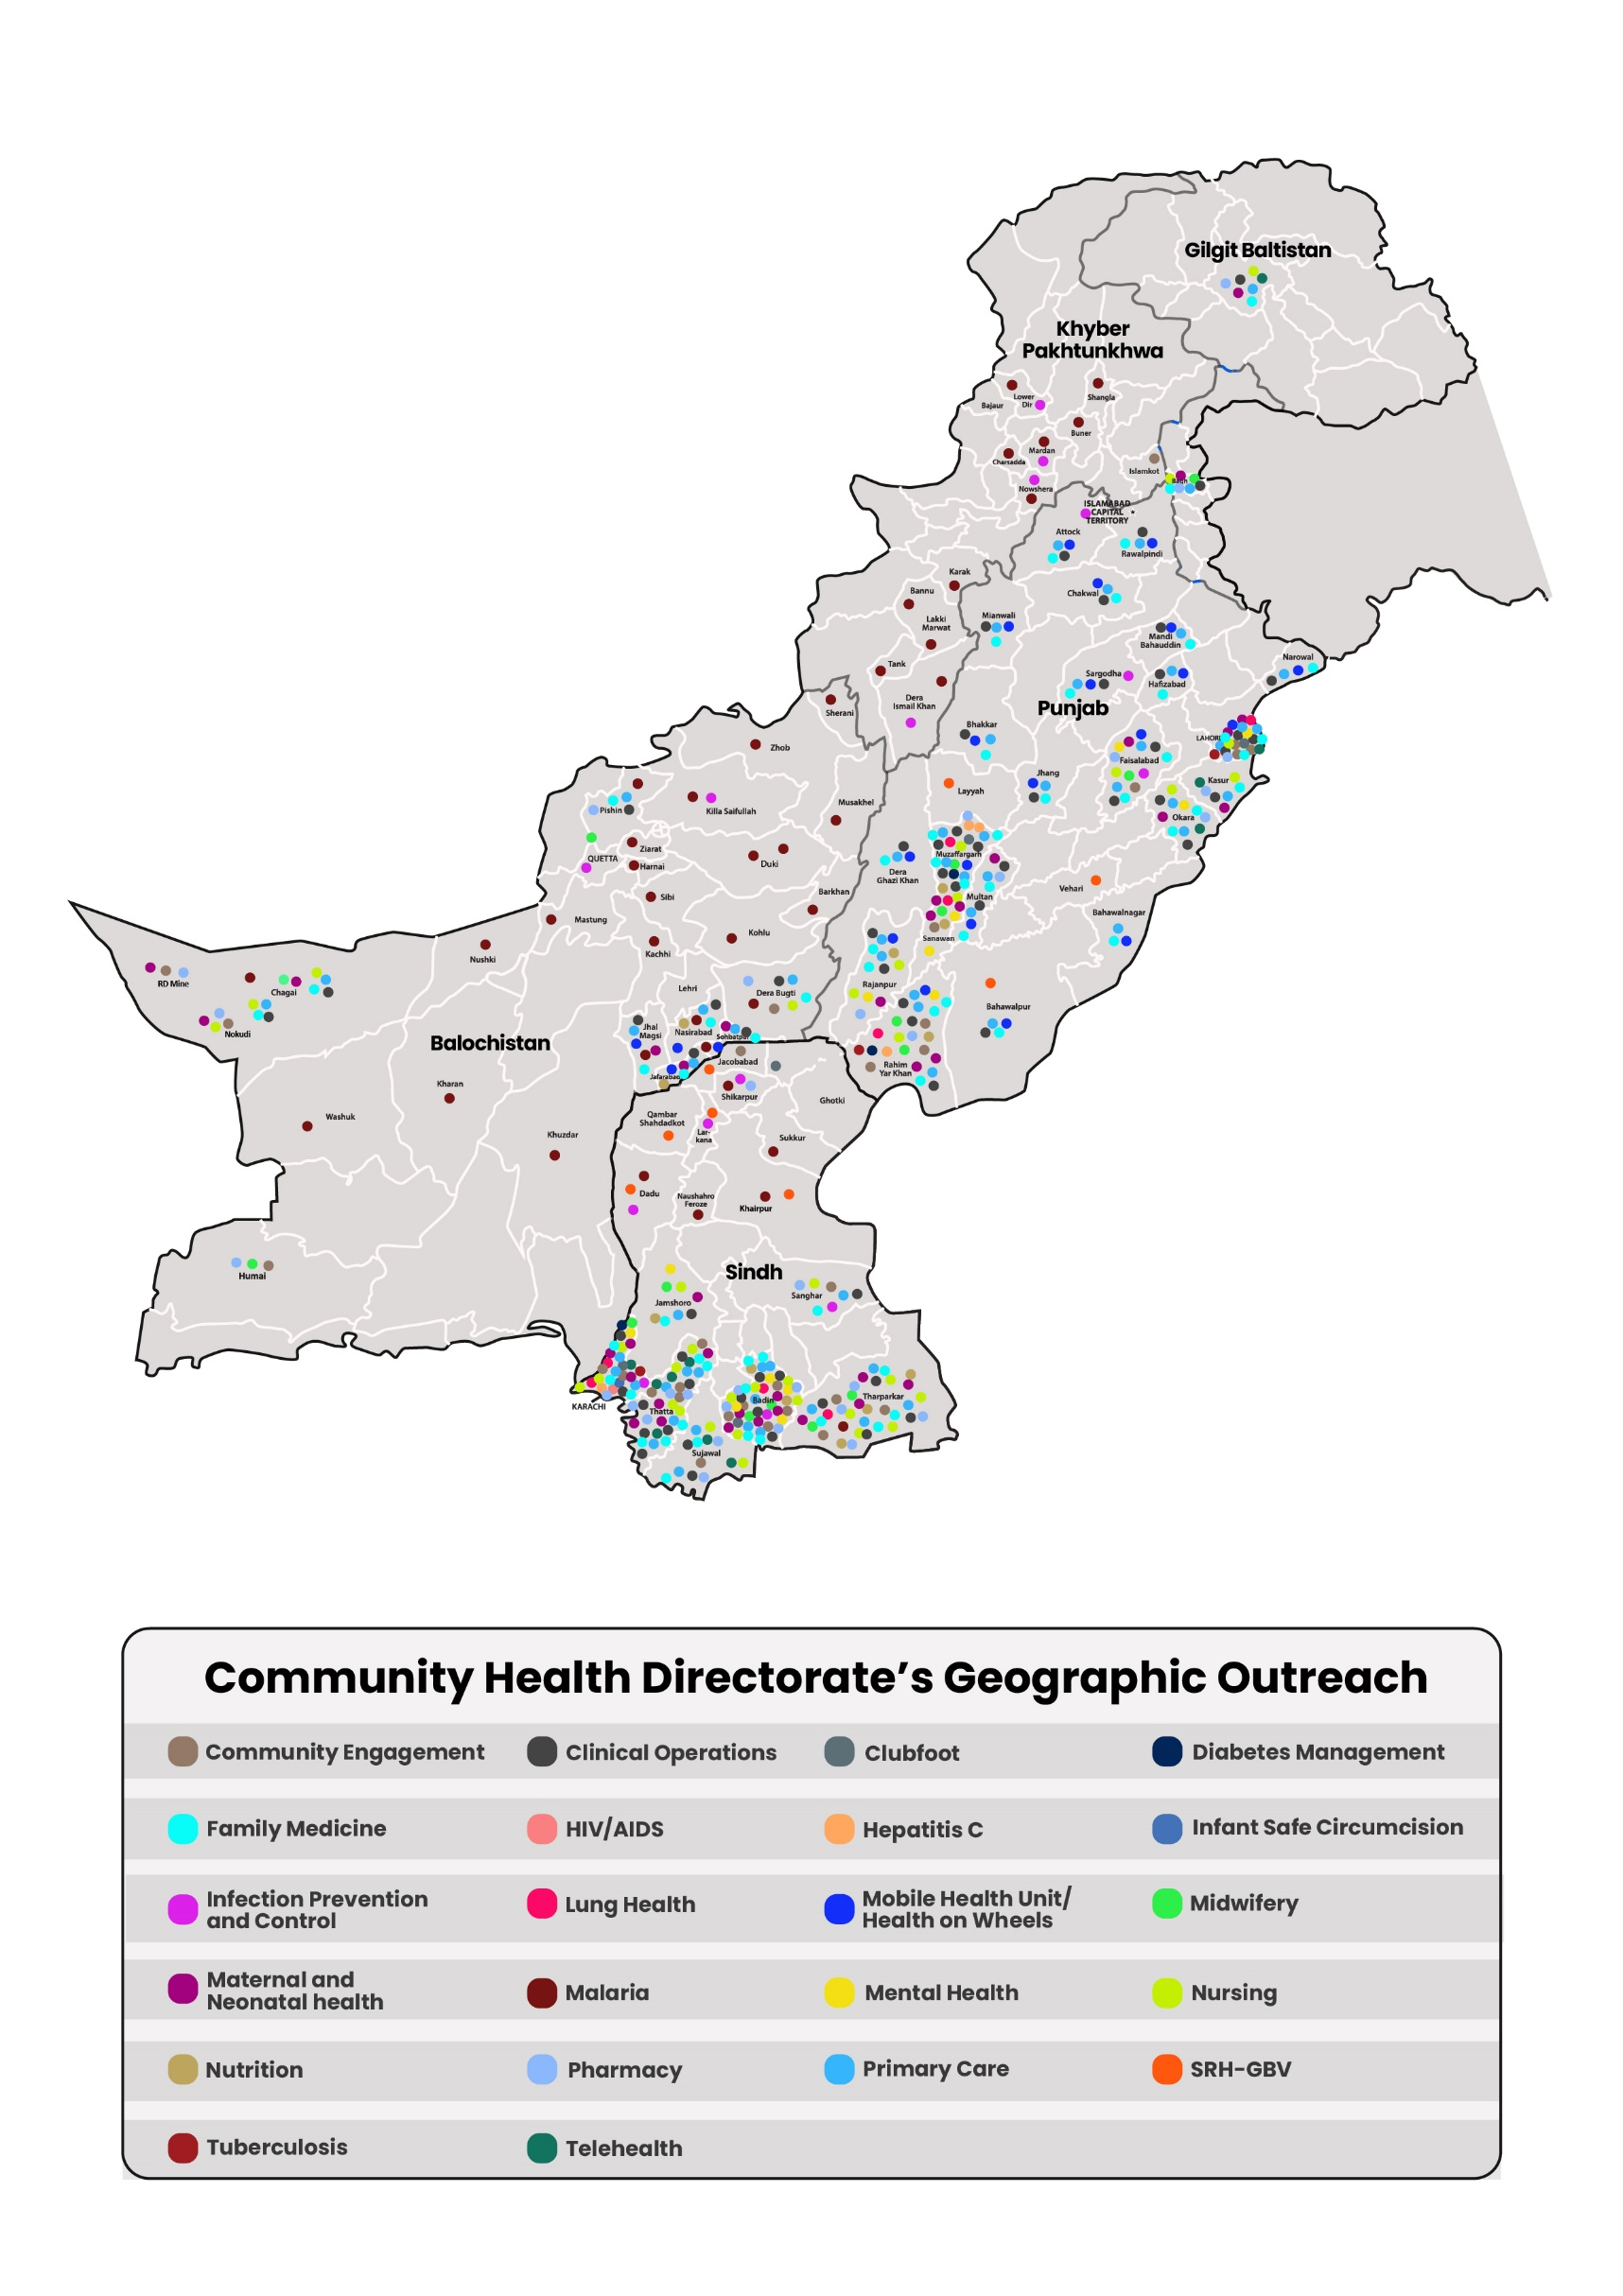
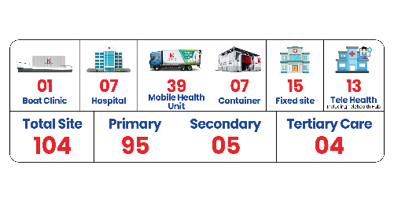
CHD’S GEOGRAPHIC COVERAGE 2025
CHD operates across Pakistan with 104 locations, providing extensive healthcare access through telehealth, mobile units, and hospitals, enhancing public health outcomes in both urban and remote areas.

Slide 9
UNDERSTANDING THE GAVI FUND MANAGEMENT MECHANISM (FMM)

Slide 10

Problem Statement at the community level
Accessibility Issues: Compromised vaccination coverage due to geographical issues including uncovered, vulnerable and hard-to-reach areas due to different terrains.
Inadequate HR: Insufficient resources at government level to address the required need at field level.
Capacity Building of Immunization Staff: Due to the limited resources the on-going training of staff members is not planned on regular basis.
Cold chain Management: Compromised cold chain at facility and outreach. Non functional ILRs at facility, and unavailability of cold chain management.
Lack of awareness and knowledge at community level: Low acceptability at community level due to lack of knowledge on immunization resulting in low uptake of vaccination.
Weak Monitoring and Accountability Mechanism: Due to resource constraints at field level regular monitoring and accountably mechanism are is in place.

Slide 11
Why FMM was needed for CSO Engagement?
Need for Local Partners: CSOs act as pivotal role to manage the mechanism and strengthen the community led process which is for the community, by the community, in the community.
- Presence at grassroot level
- Community Acceptability and Trust
- Coordination with stakeholders including community
- Ability to operate in hard-to-reach areas—enhancing equitable and inclusive immunization coverage.
Bridging Mechanism Introduced:
- Release of funds to CSOs through government is laborious process.
- Strengthening the link between communities and the health system through trusted local partners.
Strengthen Coordination with Government:
- Improved coordination with government for enhanced immunization coverage.
Strengthen Accountability and Transparency:
- Strengthened accountability, transparency, and CSO engagement in Gavi-supported initiatives. through consistent follow-up, and better coordination with provincial and district government

Slide 12
GAVI FUND MANAGEMENT MECHANISM (FMM)
GAVI FMM is implemented in the 11 countries.
Established under Gavi’s CSO Engagement Framework (2021–2025)
https://www.gavi.org/operating-model/gavis-partnership-model/civil-society
Channels funding efficiently to Civil Society Organizations (CSOs) for immunization-related initiatives (to lend hand to the Government)
Managed by Mannion Daniels in partnership with Oxford Policy Management (OPM).
Provides end-to-end grant management support from application to reporting.
Ensures transparent, accountable, and performance-based funding processes
Strengthens CSO capacity, monitoring, and alignment with national immunization goals to support government

Slide 13

HOW FMM WORKS FOR CSOs
Call for Proposals
Review & Selection
Grant Agreement
Funds Disbursement
Ongoing Support
Monitoring & Evaluation
Learning & Adaptation
CSOs submit concept notes aligned with Gavi priorities
Independent, criteria-based assessment of proposals
Due diligence and selection
Clear milestones, deliverables, and reporting timelines
Linked to progress and performance indicators
Technical assistance, mentoring, and compliance checks
Regular reporting, financial audits, and field verification
Sharing of lessons and best practices among grantees

Slide 14

HOW FMM WORKS
Resource Mobilization
This supports country-led immunization plans.
Pool financing to address gaps in vaccine delivery, cold-chain systems, and capacity building
Fund Flow Process:
Gavi Fund Manager (Mannion Danniels) Implementing Partners
Release of funds as per agreement
Fund management system:
Since government systems cannot directly fund CSOs, the FMM was introduced to onboard CSOs.
Enabled the government to engage pre-qualified partners (CSO) for service delivery in high-risk and underserved areas.
Monitoring and Accountability:
Managing transparency through financial and programmatic tracking, quarterly reporting, and independent verification
Encourages joint responsibility between CSOs and governments.

Slide 15

ROLE OF THE FUND MANAGER
Bridge between Gavi and implementing CSOs
Ensures transparent and accountable grant management
Acts as a neutral financial custodian ensuring transparent fund flow
Provides technical oversight on financial management, procurement, and reporting
Ensures compliance with donor and country systems
Facilitates timely disbursement to implementing partners
Strengthens local capacities in budgeting, auditing, and grant management

Slide 16
ROLE OF CSOs IN THE FMM
Extend immunization outreach to hard-to-reach, underserved, and high-risk populations (additional HR, capacity building and cold chain management equipment)
Mobilize communities, build trust, and counter vaccine hesitancy
Provide social accountability and feedback loops from the grassroots
Support data collection, monitoring, and documentation for transparent reporting

Slide 17
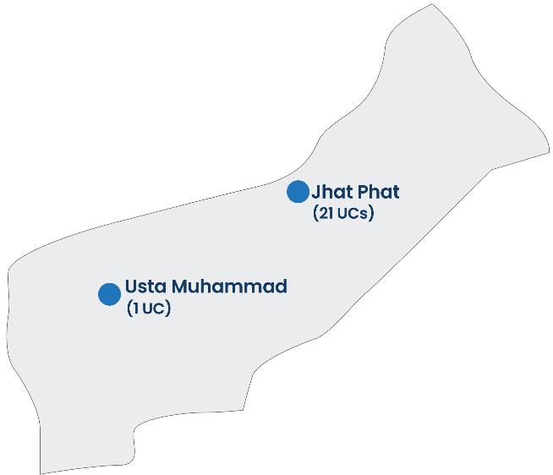
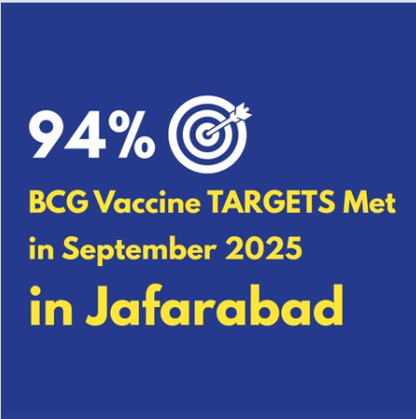
Geographically Vulnerable
Jaffarabad has emerged as a model district where IHHN’s engagement successfully bridged community trust gaps and expanded immunization coverage to reach the most vulnerable populations — particularly zero-dose children who are now being integrated into the mainstream immunization system.
Jaffarabad
2 Tehsil, 22 UCs
35 % literacy (female literacy 26%)
diverse population with a mix of ethnicities and languages.
High Mobility and Migration
Health System Constraints
Socio-Cultural Barriers

Slide 18
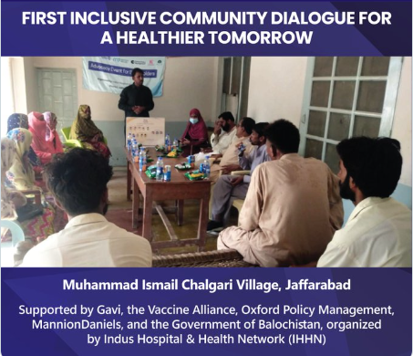
Healing Division in Chhalgari, Jaffarabad
Social conflicts had long divided the community and hindered vaccination
IHHN brought everyone together — women, men, elders, and youth — in a single advocacy session.
For the first time, people sat side by side, discussing children’s health.
“Earlier, we were not even willing to sit together. Today, we all agreed to protect our children.” Local counsellor
Unity became the strongest vaccine

Slide 19
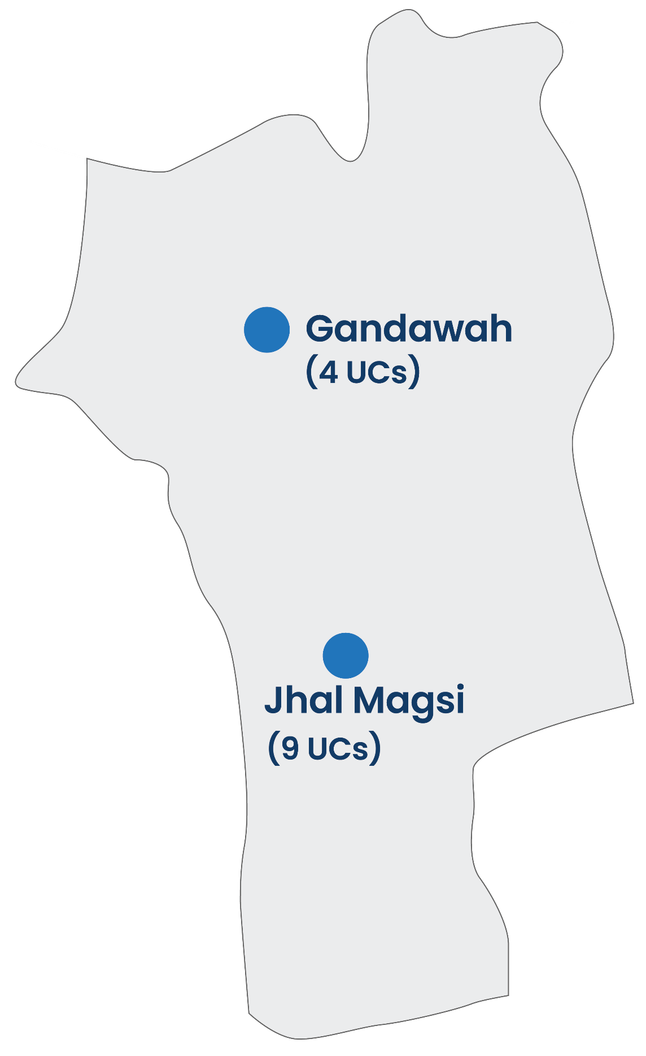
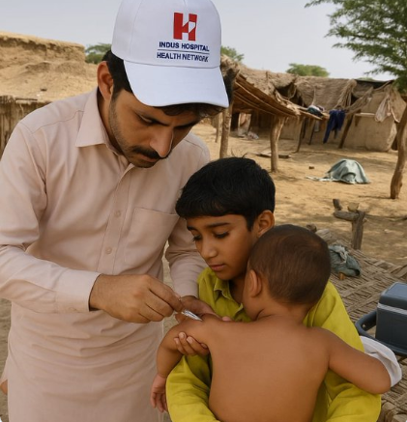
Jhal Magsi
2 Tehsils, 13 UCs
Hard-to-Reach & Scattered Settlements
Breaking Barriers in Jhal Magsi
IHHN reached the most remote corners of 4 UCs in Jhal Magsi – villages left without services since 2022
Most geographically dispersed districts
Frequent Flooding
Low Literacy & Traditional Beliefs
Few functional EPI centers
Limited health infratsture
“We didn’t just carry vaccines; we carried hope.”

Slide 20
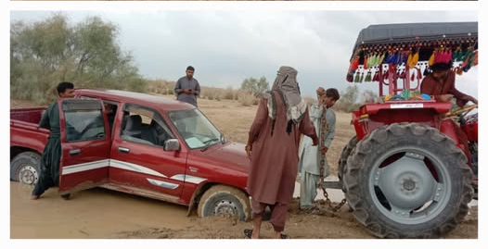
From Awareness to Action
Communities in Jhal Magsi are turning challenges into triumphs, taking ownership of vaccination and ensuring every child’s right to a healthy future.

Slide 21
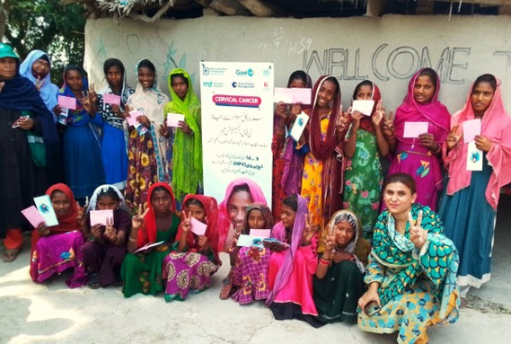
First Ever HPV Campaign
in Pakistan

Slide 22
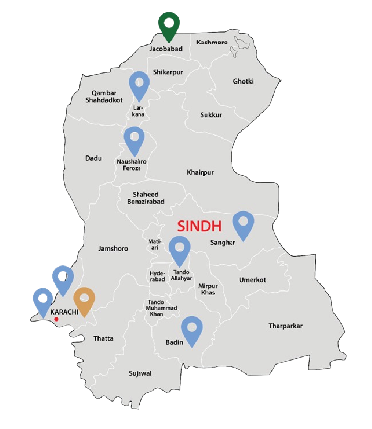
9
Districts
45
UCs
Girls Identified
Girls Vaccinated
225,296
115,322
Integrated Community Engagement

Slide 23
HITS (SUCCESSES)
Strengthened financial discipline and transparency across all processes.
Ensured Timely disbursement of funds, Timely tracking of funds and improved reporting mechanisms.
Maintained flexibility to incorporate best practices tailored to local contexts, ensuring activities reflected on-the-ground realities.
CSOs engagement provided support to Govt in improving immunization coverage.
Increased trust between Gavi, government, and CSOs.
Enabled CSOs to deliver community-level interventions effectively (Increased accessibility and improved knowledge) .
Improved alignment with national immunization priorities.
The management of CSOs through Mannion Daniels (MD) proved highly effective in supporting the government promoting transparency through clear accountability mechanisms, stronger capacity building, and consistent follow-up.
Conversely, when funds are directly managed by government entities, maintaining comparable levels of accountability and transparency becomes significantly more challenging.

Slide 24
Strong partnerships, transparent systems, and community trust are the true vaccines for sustainability
Thank You

