Slide 1
Integrating Immunisation in Primary Health Care
Voluntary Health Association of Tripura
Tripura, India

Slide 2
About VHAT
Established in 1988 as a state level net work NGOs and CBOs.
Vision: Creating excellence in Health and Socio Economic Development with priority to the less privileged section of the Society.
Implements multi-faced activities in collaboration with various Go and Non-Go organizations

Slide 3
Integration of Immunization Program into Primary Healthcare system
Fixed and outreach sessions: Immunization services are delivered to pregnant women and children on fixed days at PHCs,CHCs and community session sites like Anganwadi centers.
Intensified Mission Indradhanush in pockets with low immunization coverage, Special focus on LODOR (Left out-Dropout-Resistant)
Empowering frontline workers: ASHAs and ANMs .
Maternal and child health services: This approach offers comprehensive antenatal care and identifies high-risk pregnancies
Integration with other health programs: e.g.
- Vitamin A supplementation: Delivered alongside routine immunization for infants.
- Early infant care: Integrated into early childhood development interventions during immunization visits

Slide 4
Contd…
Digitization of vaccination records(U-WIN): The national U-WIN platform, which digitizes the Universal Immunization Program. U-WIN allows for online self-registration, tracks vaccination status, and enables beneficiaries to receive their doses at any participating facility across the country.
VHAT provided HR support to Gov. for CO-WIN & U-WIN portal data entry during COVID & post COVID period.
Incentives for workers: The state government offers additional performance-based incentives to motivate and retain ASHA workers.

Slide 5
VHAT’s Collaboration with Govt
Most of VHAT’s projects are in rural areas.
Regularly doing the awareness, vaccine readiness & community mobilization for 100% vaccination specially in low immunization coverage areas.
Working with ASHAs, CHOs ,Anganwadi Workers
Giving emphasis to Tribal and Minority community dominated areas.
Collaborating with NHM/District Immunization Officers
Actively participating in the Govt Schemes & Special drives e.g. "Swasth Nari Sashakt Parivar" through community health camps & mobilization .
We also enrolled the eligible persons in various social security schemes (Ayushman Card, E-Shram Card, PMSBY, PMJJBY etc. ) in the camps.
Works with ASHAs for mobilizing beneficiaries to take benefit of Pradhan Mantri Matru Vandana Yojana (PMMVY).

Slide 6
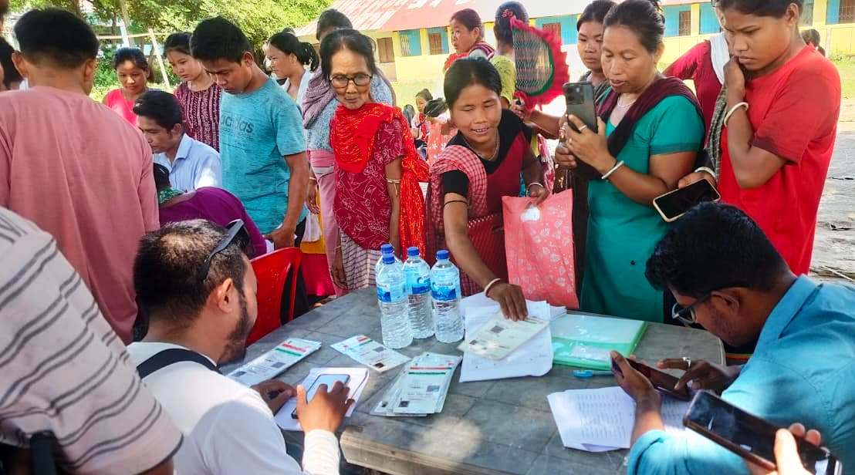
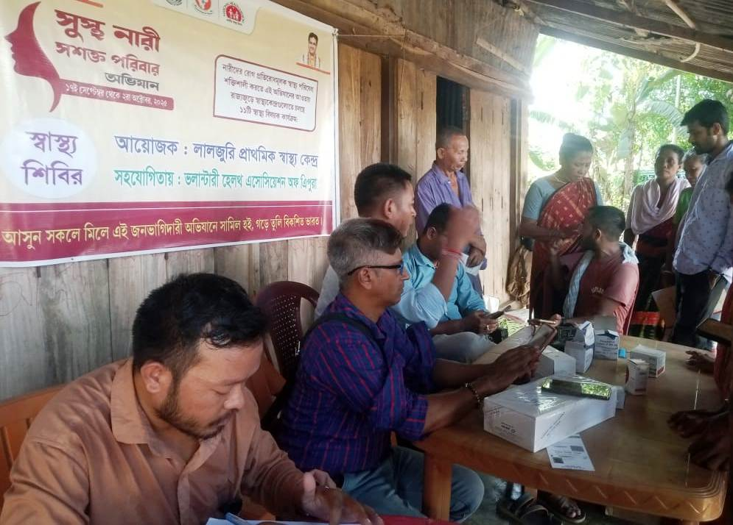
Participating in Special Drive - Swasth Nari Sashakt Parivar
VHAT collaborating with Laljury PHC in Health Camp (North Tripura Dist) and also helping in enrolling the women for the Scheme

Slide 7
CHALLENGES
•Geographic and logistical barriers: Rural and tribal populations face hurdles in
accessing health facilities due to poor road conditions and limited transportation.
(Solution-mobile clinics and outreach sessions to serve remote villages and migrant settlements.)
• Vaccine hesitancy: Despite campaigns, misinformation and fear of side effects remain barriers to full immunization coverage.
(Overcoming this requires continuous, effective communication tailored to local communities).
•Data monitoring and feedback: Continuous monitoring are vital for identifying coverage gaps and making necessary program corrections.

