Slide 1
Gavi CSO Consultation Webinar Webinaire de consultation des OSC de Gavi
Gavi CSCE 2025 Webinar #2 Reaching Communities in Crisis: How CSOs Deliver Impact in Fragile Settings with Gavi Support
18 September 2025; Created by Kati Collective

Slide 2




Housekeeping / Ménage
Use chat feature to post links/reactions
Utilisez la fonction de chat pour publier des liens/réactions
Use chat function to post questions
Utilisez la fonction de chat pour poser des questions
ENG-FR translation available – use the globe button
Traduction ANG-FR disponible – utiliez le bouton globe
Slideshow & recording shared following the session
Diaporama et enregistrement partagés après la séance

Slide 3
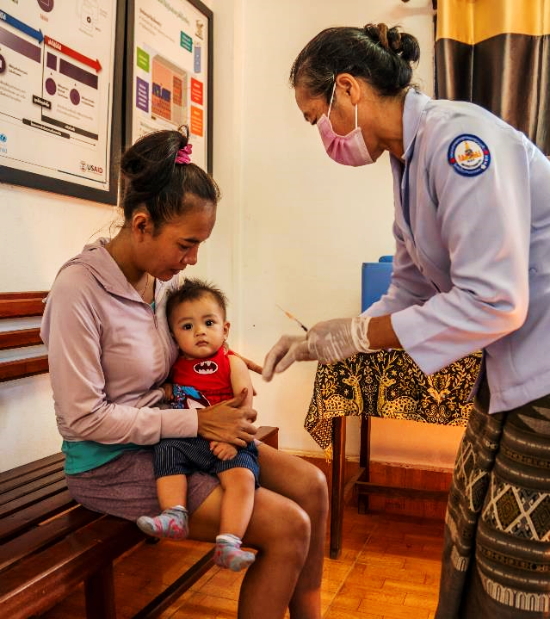
AGENDA
Welcome & Gavi’s Vision for CSOs in Fragile & Humanitarian Settings
Gavi CSO Spotlights
CSO Dialogue
IV. 6.0 Strategy FH Briefing & CSO Board Rep Update

Slide 4
Welcome
Bienvenue

Slide 5



CSCE 2025 Webinar Series and CSO Consultations: a platform to listen, learn, and shape the future of CSO engagement
Insights directly from implementing CSOs
Webinar#3: Influencing Policy and Equity: How CSOs Strengthen Gavi’s Work Across the Health System
16 October
Webinaire n° 3 : Influencer les politiques et l’équité : comment les OSC renforcent le travail de Gavi dans le système de santé
16 octobre
Informational and consultative
Gavi seeks candid feedback, concrete recommendations, and forward-looking collaboration

Slide 6




Today’s Webinar and Consultation Thematic Focus In fragile and humanitarian settings, what will it take for Gavi and CSOs to sustain immunisation services amidst crisis, while building the foundations for long-term resilience?
Contexts and Challenges
Contextes et défis
Adaptations to Service Delivery
Adaptations à la prestation de services
Partnerships with humanitarian actors and government
Partenariats avec les acteurs humanitaires et le gouvernement
Strengthening support and resilience
Renforcer le soutien et la résilience

Slide 7
Gavi’s experience with CSOs in Conflict and Fragile settings
Gavi worked with 200+ CSOs – INGOs, local and community organisations
CSOs delivered services, built trust, outreach, mobile clinics, and supply
Gov’t-led engagement, complemented by ZIP and other modalities, enabled reach
Trusted intermediaries negotiated access and mobilised communities effectively
Delivery often complex, requiring flexibility, sometimes higher costs, integration

Slide 8
CSO Spotlights
Pleins feux sur les OSC:
APEC
IFRC/PRCS
Save the Children

Slide 9


APEC RDC
Présentateur :Lala Assy

Slide 10





APEC – contribuer à la réduction du nombre d'enfants zéro dose en collaboration avec les acteurs communautaires au Sud-Kivu, RDC
Aperçu
Description du projet
Intervention :
Activités au niveau communautaire
Objectif :
Contribuer à une réduction d'au moins 35 % du taux d'enfants zéro dose au Sud-Kivu d'ici fin 2025
SANRU, APEC, 15 OSC locales, DPS Sud-Kivu, BCZs, Association locales, CAC, PFU
Parties prenantes :
Lieu : Sud-Kivu, RDC
Mesure d'impact 1 :
L’intégration dans le système passe par :
Participation aux réunions de coordination et validation des données
Suivi de la remontée des données communautaires dans le DHIS2Tracker
Contractualisation avec les associations locales de mise en œuvre
Accompagnement des organes de participation communautaire pour identification et suivi des enfants zéro dose et sous vaccinés
10 940
Budget : 641472$
Enfants dose zéro identifiés
Mesure d'impact 2 :
Principaux résultats :
3036 CAC ont été redynamisées dans les 15 ZS FAE
30 Leaders d’opinion ont été formés en approche HCD dans les 15 ZS FAE
237 sur 283 PFU mis en place sont opérationnelles soit 84%
283 diagnostics communautaires sont réalisés chaque trimestre
De janvier à juin 2025, 88% d’ ESV, soit 12803 ESV, ont été récupérés sur le 14 528
Durée du projet :
Sept. 2023 –
déc. 2025
9563
Enfants zéro dose vaccinés

Slide 11
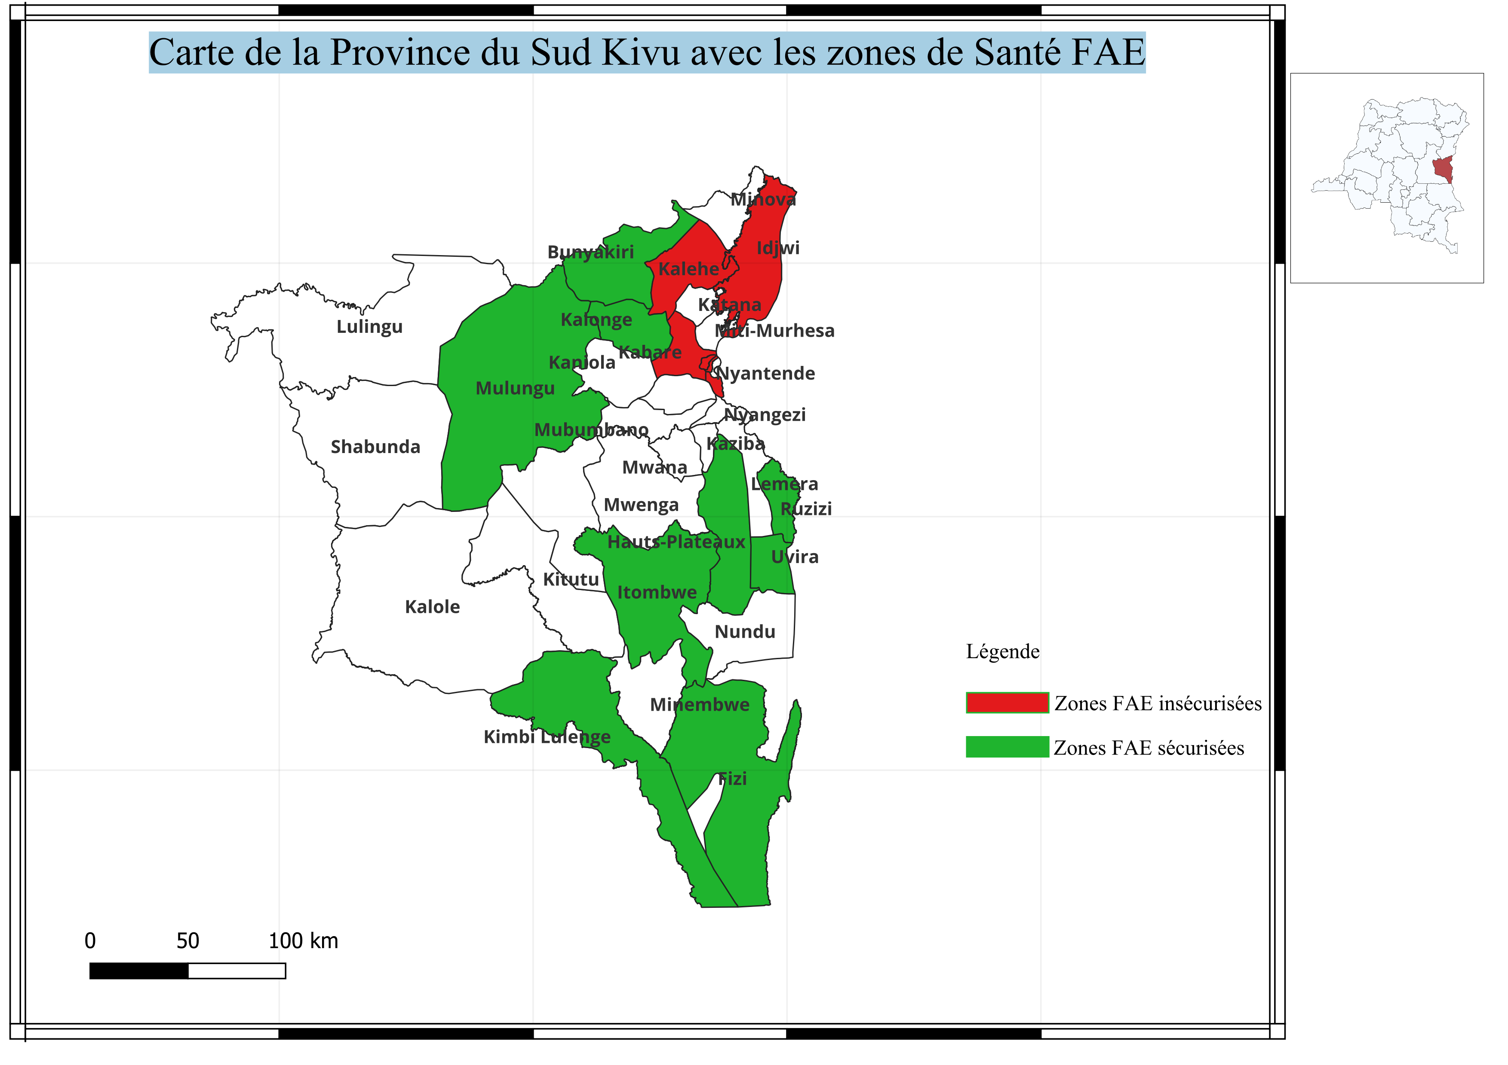
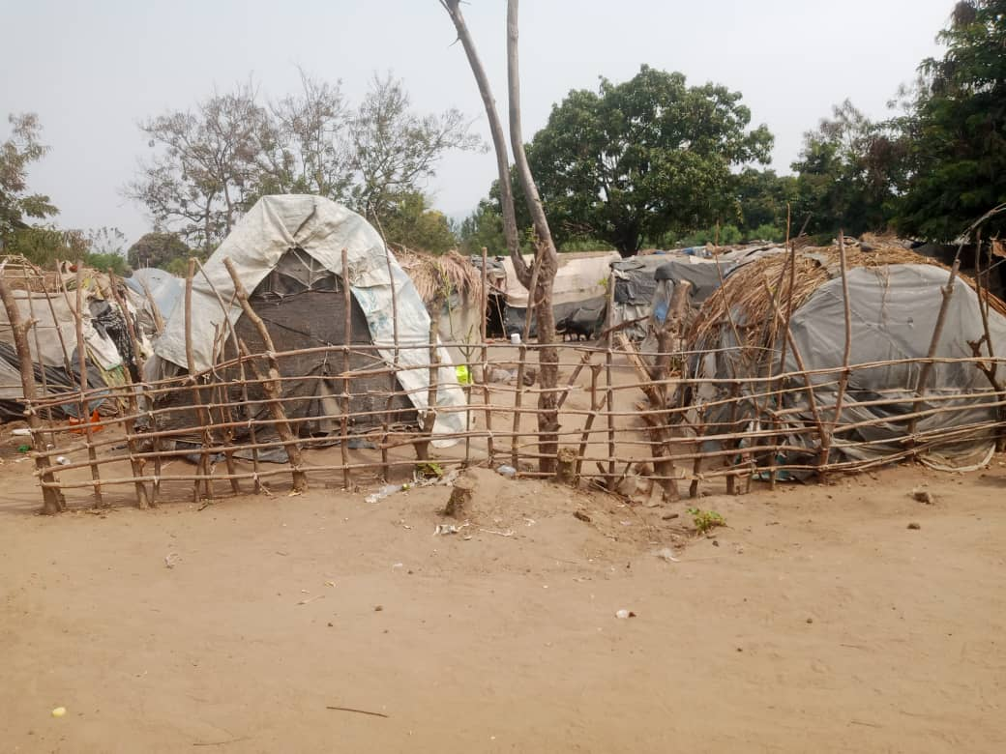
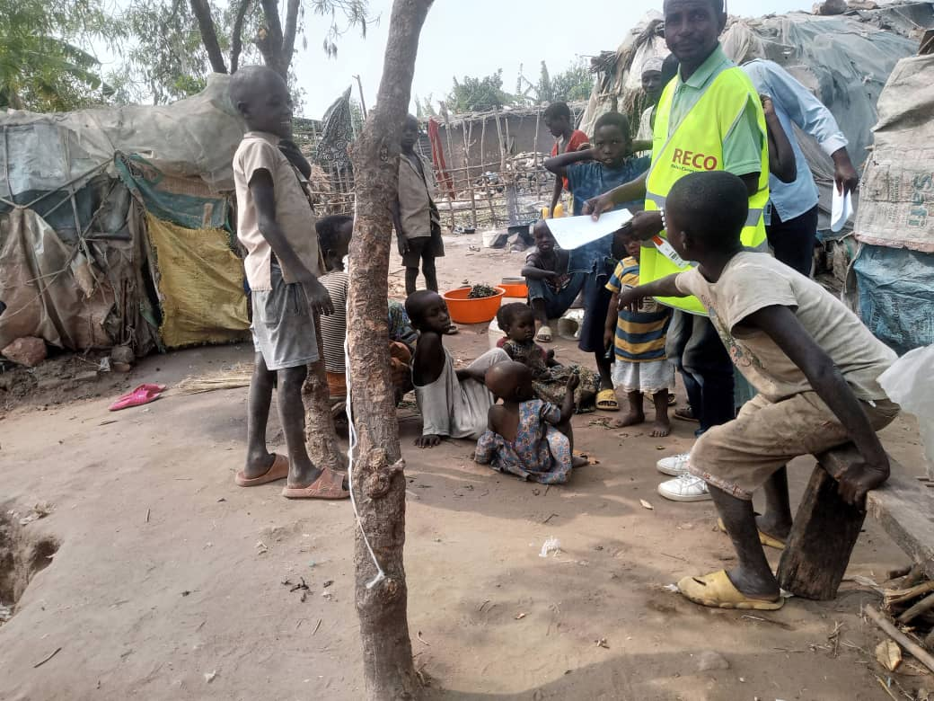
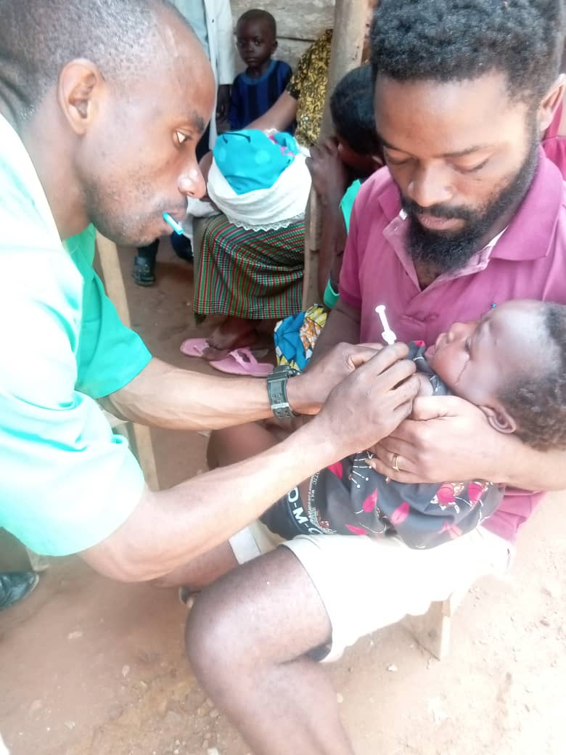
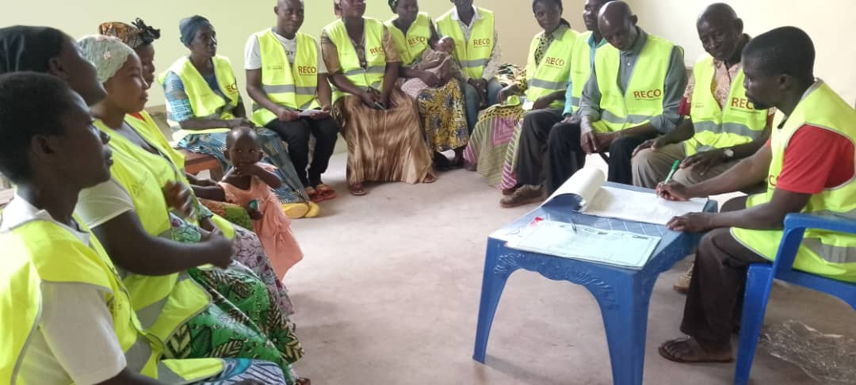
APEC – contribuer à la réduction du nombre d'enfants zéro dose en collaboration avec les acteurs communautaires au Sud-Kivu, RDC
Aperçu
Photos de terrain
Aperçu
Carte
Le projet est mis en œuvre dans 15 ZS soutenant 283 aires de santé, en se concentrant sur les communautés zéro dose et sous-vaccinées.
Les ZS du projet FAE sont coloriées en vert

Slide 12
APEC – contribuer à la réduction du nombre d'enfants zéro dose en collaboration avec les acteurs communautaires au Sud-Kivu, RDC
Victoires et succès du projet
Principaux défis à relever
Recommandation à Gavi
Aperçu
Aperçu
Aperçu
Aperçu
Aperçu
1
Le réseau des OAC, CAC, PFU, CODESA sous la coordination d’APEC qui jouissent du statut neutre a permis le renforcement du financement des OSC, la pérennisation du diagnostic communautaire par plateforme des usagers et la poursuite des activités dans le contexte de conflit armé au Sud Kivu de janvier à ce jour.
1
L’insuffisance des outils de collecte des données communautaires entraine la deperdition des données. Retard dans le décaissement des fonds pour assurer un déroulement régulier et efficace des activités. La période du décaissement des fonds ne correspond pas à celle de réalisation de l’activités.
Connexion internet limitée (faible visibilité des données dans DHIS2)
1
Reproduire les outils CAC, RECO, CODESA, UCODESA, Task Force Communication, por que la période de décaissement corresponde à la période de mise en œuvre des activités sur terrain.
2
Dans les 6 zones en proie à l’insécurité, 3 408 enfants ZD sur 4 018 (84,8 %) et 4 261 enfants SV sur 4 879 (87,3 %) ont été récupérés, contre 9 563 ZD sur 10 940 (87,4 %) et 12 803 SV sur 14 528 (88 %) dans l’ensemble des 15 zones entre janvier et juin 2025.
Les zones affectées ont atteint des niveaux de récupération proches de la moyenne globale des 15 zones de santé appuyées, traduisant une résilience importante des interventions communautaires.
2
Insécurité :
L’appui à la vaccination des enfants dans un contexte d’insécurité permanente dans une grande partie de la province. L’occupation de 6 ZS (Bagira, Kadutu, Kabare, Kalehe, Nyantende et Idjwi) sur 15 par la rébellion constitue un sérieux problème dans le suivi des activités sur terrain.
2
Plaidoyer auprès des parties en conflit pour assurer l’équité vaccinale pour tous les enfants. Renforcer la capacité de négociation d’accès dans les zones à conflits pour assurer le suivi des activités communautaires sur terrain.

Slide 13
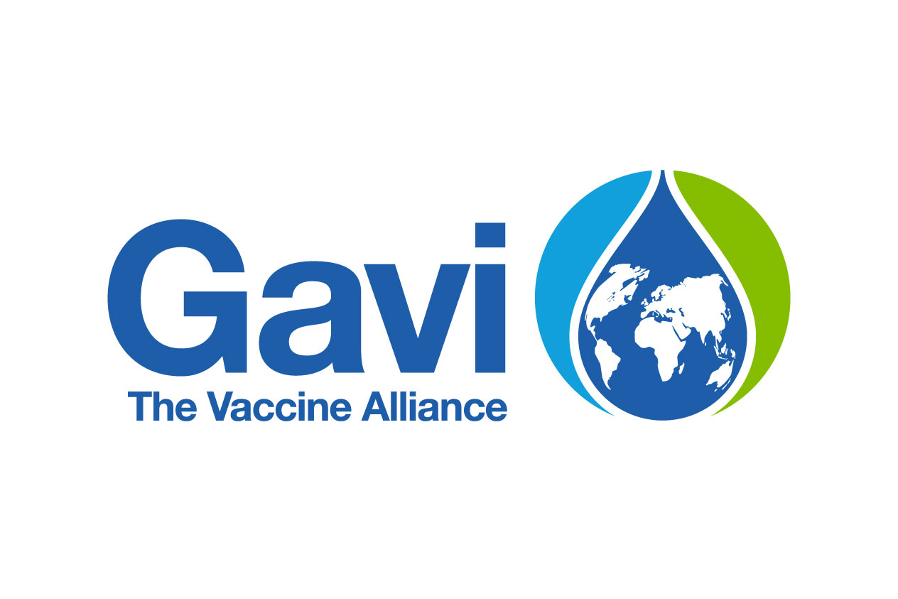


Palestine Red Crescent Society PRCS-
ensuring access to routine immunizations and
maintaining vaccination coverage in an acute humanitarian crisis
Presenter: Dr Bashar Morad, Rami Hijjo, Tasneem Obaid

Slide 14
Ensuring access to routine immunizations and maintaining
vaccination coverage in an acute humanitarian crisis
Overview
Project Description
Intervention
area: service delivery, community engagement
Objective: Conflict resilient routine immunization
PRCS is ensuring that hard-to-reach, displaced, and zero-dose children are systematically included in service delivery despite access constraints, displacement, and humanitarian emergency
Location: Gaza
As an auxiliary to the MoH, PRCS delivers RI through five fixed sites and temporary medical points in shelters and displacement areas, identifying and vaccinating zero-dose and under-immunized children
Impact metric 1:
17,013
Investment amount:
7.3 million USD
Children reached with ≥1 routine dose
PRCS has mitigated health worker shortages by engaging retired MoH staff with vaccination expertise.
To protect staff security, PRCS coordinates movement with OCHA and ICRC, joining convoys and using short access windows in high-risk zones.
PRCS mobilizes its volunteer network to deliver community awareness sessions in shelters and displacement sites, supporting demand generation and monitoring of RI services. 60 trained volunteers have been engaged in their communities to map shelters, trace defaulters, and promote vaccination uptake among zero-dose and under-immunized children.
Impact metric 2:
20,331
Project duration:
September 2024 to December 2025
Doses of routine immunizations administered

Slide 15
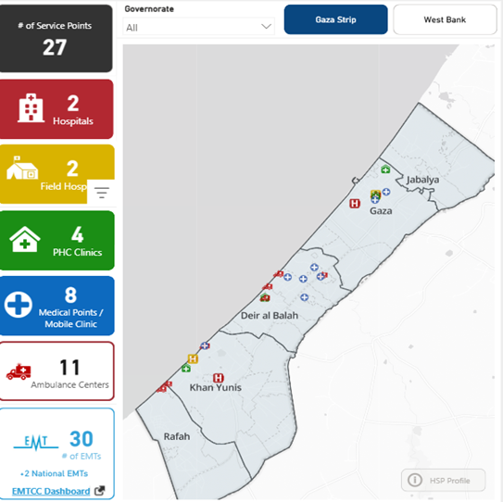
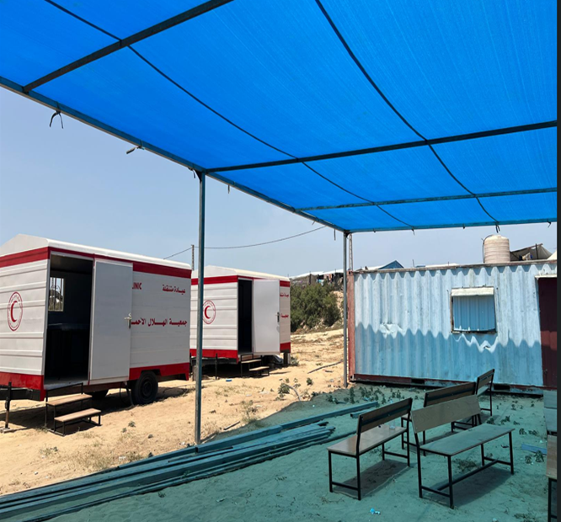
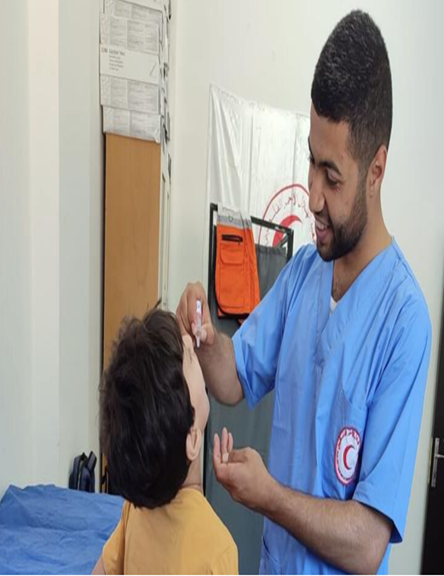
Intervention sites
Field photos
Haitham Bassam Abu Issa, a nurse vaccinator at a PRCS clinic,
was killed in Deir al-Balah by an airstrike,
He was loved, motivated and dedicated to protecting children
through vaccination
A medical point established within weeks after the destruction of a PRCS fixed immunisation PHC
Medical points highlighted in blue and PHCs in green

Slide 16
PRCS: Strengthening Its Role as a Local Health Actor
As a local actor, PRCS is leveraging its reach within communities in Gaza to deliver immunizations, building on its existing health capacities—including EMS, hospitals, and health posts—and strengthening the skills and commitment of its staff and volunteers at the community level. Despite restricted access, PRCS has maintained operational continuity.
Effective coordination is essential, including:
Actively participating in EPI technical coordination structures: align immunisation efforts with MoH and Alliance planning and closely follow deconfliction windows.
Ensuring all CSO data is reported to and recorded in MoH records, avoiding parallel structure. A plan is underway to link the reporting to Sehaty app for streamlined approach.
Community-level engagement: shelter/ camp managers for IDP sites, MoH and community leaders to micro-plan vaccination sites, session timing, and crowd flow.
‘PRCS bridges the gap between communities and health systems; empowering them as strategic partners strengthens trust and ensures access to hard-to-reach populations.’

Slide 17
Project successes and achievements
Recommendations to Gavi
1
17,013 children reached with at least one vaccine dose (Apr –Aug 2025)
20,331 antigens administered including: Penta: 2,642. Polio/IPV: 8,081. MCV: 1,856
More than 40 immunization awareness sessions have been conducted in IDP sites
PRCS was a key partner in 3 rounds of nOPV campaigns (2024-2025)
Despite short access windows, strong micro-planning enabled delivery at scale.
PRCS reached nearly 100% of targeted children in its areas of operation, with the MOH relying heavily on PRCS to reach hard to reach areas like North Gaza
1
Institutionalize central MoH–CSO coordination (EPI): a clear streamlined coordination channel with clear focal points, mirrored at subnational level with shared micro-plans.
Empower local, context appropriate, and community accepted organizations to be strategic partners in immunization planning and service delivery by:
Advocating with MOH to expand immunization service delivery partners to include local CSOs who are trusted by communities and can reach hard-to-access populations
Providing flexible and dynamic funding that empowers local actors to make field appropriate, timely adjustments to operations during acute humanitarian crises
Adopting a greater tolerance for risk and a no regrets mindset. This may involve accepting less detailed budgets and streamlined reporting requirements. Such an approach enables local organizations to direct their efforts and resources toward urgently reaching missed children and preventing outbreaks, rather than heavy reporting requirements.
Enabling CSOs to integrate immunization activities with other urgent, context-specific humanitarian and primary health priorities, for example nutritional supplements and WASH, ensuring a more holistic and efficient response in fragile settings and avoiding missed opportunities
Aperçu
Aperçu
Aperçu
Aperçu
2
2
3
3
4
4
5
5

Slide 18




Save the Children - Sudan
Presenter: Dr. Bashir Kamaleldein
Health and Nutrition Director
Sudan

Slide 19
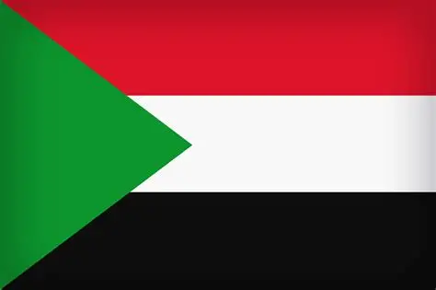
Save the Children – Sudan Hard-to-Reach Areas Consortium
Overview
Project description
Intervention:
Multi-sector, focusing on PHC strengthening
Aim:
Multisector operation on Health & Nutrition, Child Protection, Safeguarding, Education, FSL at 10 out of 13 states in Sudan, focusing on PHC strengthening, immunisation service delivery and reaching zero-dose children
Save the Children and consortium partners, national and subnational EPI teams, including FMOH, MOHs and PHC directorate
Key Stakeholders:
Location : 11 of 13 states in Sudan
Impact measure 1 :
Save the Children is integrated side-by-side and through the system through resourcing, logistics and operational support to the EPI program:
Active in national and state planning and coordination forums.
Supports MoH/EPI with rehabilitating facilities, vaccinators, and outreach/mobile delivery.
builds community-based structures, M to M SG ,volunteers, and immunisation referrals
Support partners working under GAVI support as a consortium lead
460,918
Budget : $12 million
Children vaccinated
Main achievements:
Health worker training: Trained 897 health workers on immunisation
Supervision: Supportive mentoring and adherence to standards.
Community engagement: builds community-based structures, ICCM volunteers, and referrals for immunization 85 mother to mother support groups
Fight vaccine hesitance through tailored health promotion language
Generate evidence on vaccination coverage zero dose children distribution and reasons behind missing the vaccine, including improving reporting for VPDs and timely reporting
Impact measure 2:
Length of project:
1 year
125,373
Zero-dose children reached

Slide 20
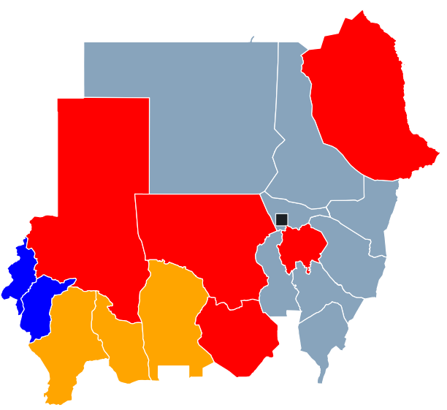
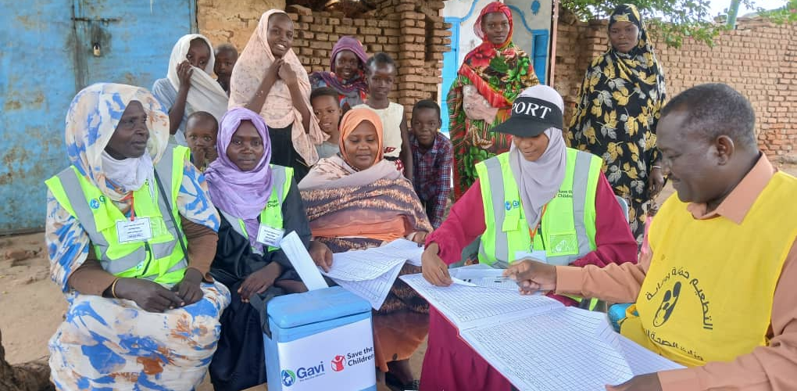
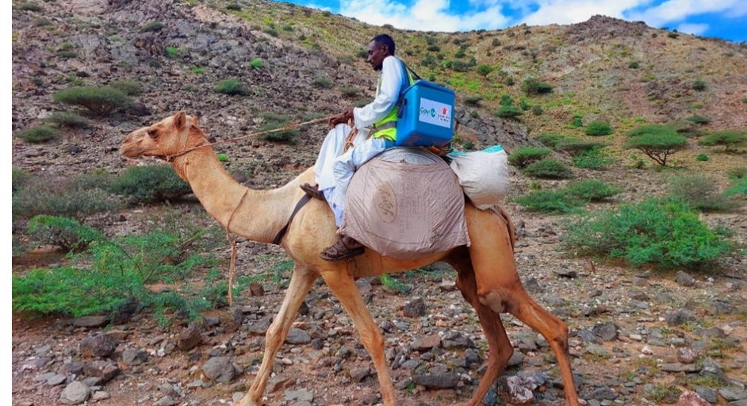
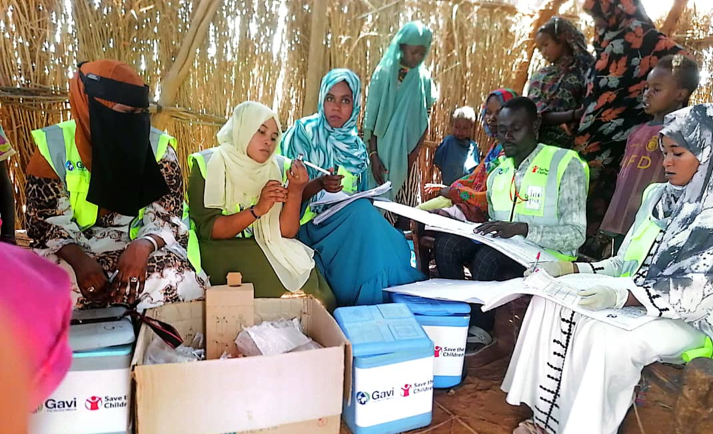
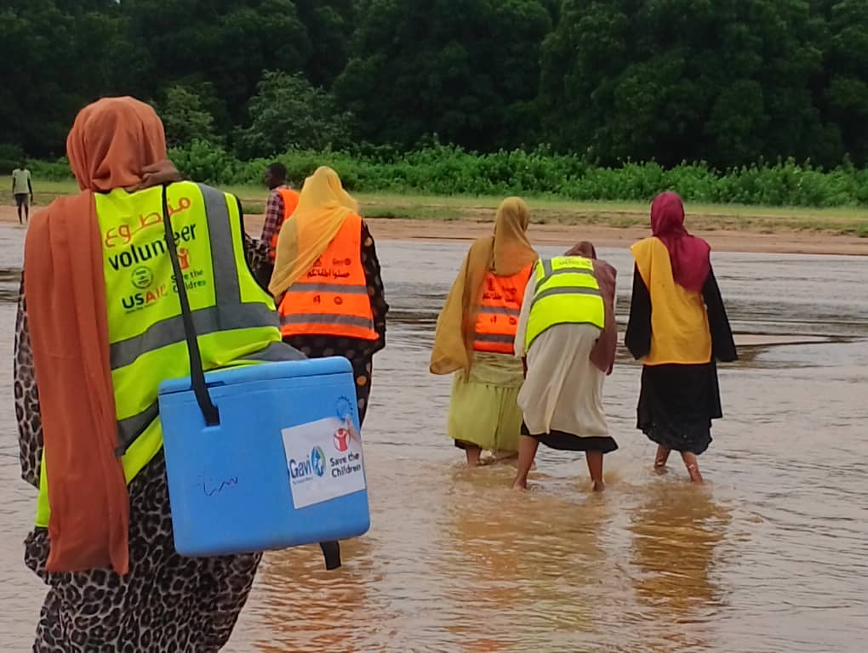
Save the Children – Sudan Hard-to-Reach Areas Consortium
Overview
Overview
Overview
Map
Field photos
Overview
The Project is implemented in 10 states, supporting 123 localities, focusing on zero-dose and under-immunised communities.
N.B. project states are in red (SCI), blue (IMC) and orange (Alight),

Slide 21
Save the Children – Sudan Hard-to-Reach Areas Consortium
Project successes
Main challenges
Recommendations to Gavi
Aperçu
Aperçu
Aperçu
Aperçu
Aperçu
1
Supporting operation of morethan1655 immunisation sites across 10 hard-to-reach states, including provision of cold chain equipment. These efforts have contributed to improved Penta 1 reach from 47% to 71% within 6 months.
1
Beyond "Country-Led" to "Community-Owned": Gavi's country-led approach is a strong foundation, but moving beyond national levels to empower sub-national and community structures need to be considered. This includes supporting local health committees, community-based organizations, and other grassroots initiatives.
1
Focus on Zero-Dose and Missed Communities: This must remain the absolute priority. Gavi should scale up its efforts to identify and reach these communities, which are often in fragile or conflict-affected areas, urban slums, or remote populations. Innovative approaches, such as micro-planning and community-led delivery models, are crucial to ensure equitable access.
2
The project has increased vaccine coverage in the Red Sea state almost tenfold in the last year, from 3382 children vaccinated with Penta 1 in January, to 29,390 children vaccinated with Penta 1 in December.
2
Given the developing humanitarian and conflict context in Sudan, it has been a challenge to integrate immunisation services into Save the Children’s humanitarian response.
2
Market Shaping: Gavi's unique position allows it to influence vaccine markets, drive down prices, and encourage the development of new, affordable vaccines. This capability should be leveraged to ensure a stable supply of new and existing vaccines, especially for diseases which are increasingly important.
The most powerful quote from my experience, which resonates with the challenges we face, is "Despite what has happened, we must continue.” This is more than just a phrase; it's a mindset. It’s a call to action to persevere, innovate and collaborate.

Slide 22
CSO Dialogue
Dialogue avec les OSC

Slide 23
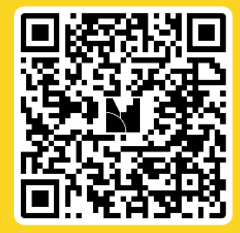
Go to www.menti.com
use code 3741 7849
or use QR Code
Rendez-vous sur www.menti.com et
utilisez le code 3741 7849
ou le QR code

Slide 24
Gavi 6.0 Fragile & Humanitarian Settings

Slide 25
Gavi’s FH Approach addresses 4 problems
6.0 Goals & objectives
Lack tailored application to achieve Gavi’s goals and objectives for Fragile & Humanitarian settings
1
Gavi’s policies and programmes not well-suited for complex fragile & humanitarian settings
2
6.0 Policies &
Programmes
Secretariat grant management not geared towards specificities of F&H settings
3
6.0 Secretariat operating model
Limited collaboration and coordination at global and country levels, including with the humanitarian response, humanitarian partners (e.g., GPEI) in F&H settings
4
6.0 Partnership
model
Global ecosystem: Gavi operates in a global ecosystem which this approach must align and contribute to, and from which contributions are needed
25

Slide 26



ZIP, Gavi’s 5.0 Humanitarian Partnerships
FULL VACCINATION FOR CHILDREN 0-5 IN CONFLICT AND CRISIS SETTINGS
19.5M VACCINE DOSES ADMINISTERED FROM DECEMBER 2022 TO JULY 2025
Current Partners
2022–2025
Historical Partners
2022-2024
2022-2024
Burkina Faso
Cameroon
CAR
Chad
Mali
Niger
Nigeria
2022-2025
Chad *
Ethiopia
Nigeria *
Somalia
South Sudan
Sudan
* Added in 2025
2025
Cameroon

Slide 27

Theory of Change outlines clear levers of influence, interventions, outcomes and goals for the F&H approach
Levers Priority interventions Outcomes
Goals
Systematic advocacy for immunisation, equity imperative, and access to vaccines
Harmonised policies and operationalised differentiated risk appetite
Responsive and timely access to vaccines and funding
Flexible grant programming for
proven partners
Established skillset at Secretariat for fragile and humanitarian settings
Intentional engagement with humanitarian sector
Timely and relevant data for decisions and accountability
1. Focus on context- appropriate vaccines
Immunisation coverage
is maintained or increased
SG1: Introduce and scale up vaccines
2. Provide differentiated health system support
Missed communities and zero-dose children reached
SG2: Strengthen health systems to increase equity in immunisation
3. Strengthen humanitarian partnerships
Immunisation is embedded in humanitarian programming
SG3: Improve programmatic & financial sustainability
4. Provide responsive support for fragility, emergencies and outbreaks
Continuity of immunisation despite shocks
2
2 Board Meeting, 24-25 July 2025

Slide 28
Seven strategic shifts to Gavi’s delivery model will enable the outcomes and goals in the ToC
1
2
3
4
5
6
7
Strengthen and increase coverage with context-appropriate vaccines
Differentiate health systems support to missed communities and zero-dose children aged 1-5 years old
Institute new ways to direct vaccines and cash to missed communities
CSO partnership
opportunities
Support subnational settings and F&H settings in catalytic phase countries
Establish immunisation as a humanitarian health practice
Create a dedicated ‘Gavi Resilience Mechanism’
Ensure a better equipped Gavi Secretariat
3 Board Meeting, 24-25 July 2025

Slide 29
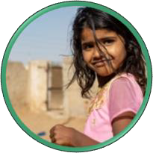
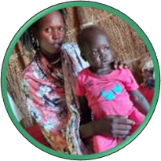
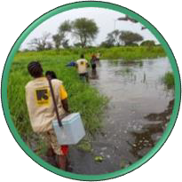
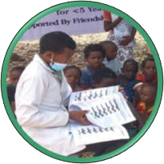
Gavi has created a dedicated Resilience Mechanism to respond to unforeseen needs, with four use cases
Newly-arising needs in chronically fragile settings
Emergencies including outbreaks
Only outbreak support not covered through existing mechanisms
Settings that require humanitarian programming
‘ZIP-like’, routine immunisation and catch-up for zero-dose children
Catalytic phase countries¹ facing fragility or emergencies
Routine immunisation and outbreak response support
4 Board Meeting, 24-25 July 2025
1. Lower-middle income countries or countries eligible to borrow from the International Development Association (IDA-eligible); 2. Of the US$ 405 - 415 million, US$ 195 million was already included in the June 2024 Gavi 6.0 cost estimate and entails a reallocation of US$ 135 million from the Gavi 6.0 HSS ceiling to the GRM. The remaining amounts are additional and included in the updated Gavi 6.0 financial forecast for discussion by the Audit and Finance Committee at its meeting on 17th July 2025

Slide 30
Gavi Board-Approved Funding
Total additional costs to deliver F&H Shifts | $380m
Of which GRM | $294m
Of which support for traditional Vaccines | $47m
Of which support for catch-up of missed children up to age 5 | $40m
Cash to F&C | $780m
Vaccines to F&C | $1,719m
Expected Impact
2.4-2.7
million
lives saved
>

Slide 31
Open Q&A
Please raise your hand or use the Zoom Q&A function to type your question
Veuillez lever la main ou utiliser la fonction Q&R de Zoom pour taper votre question.

Slide 32
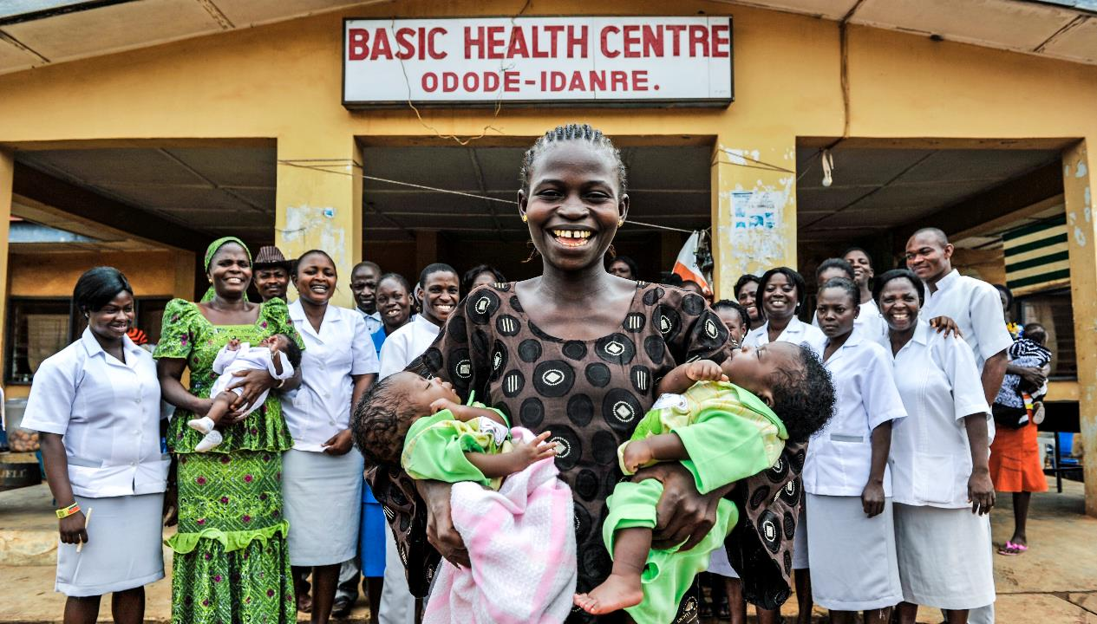
“A world in which civil society organisations are integral partners in a vibrant, strong social movement towards reaching countries' immunisation goals.”

