Slide 1
CSCE Webinar and CSO Consultation
Gavi CSCE 2025 Webinar #1Building Resilient Health Systems: How CSOs are Driving Gavi’s Immunisation Impact
07 August 2025

Slide 2




Housekeeping
Use chat feature to post links/reactions
Utilisez la fonction de chat pour publier des liens/réactions
Use Q&A function to post questions
Utilisez la fonction Q&R pour poser des questions
ENG-FR translation available – use the globe button
Traduction ANG-FR disponible – utiliez le bouton globe
Slideshow & recording shared following the session
Diaporama et enregistrement partagés après la séance

Slide 3
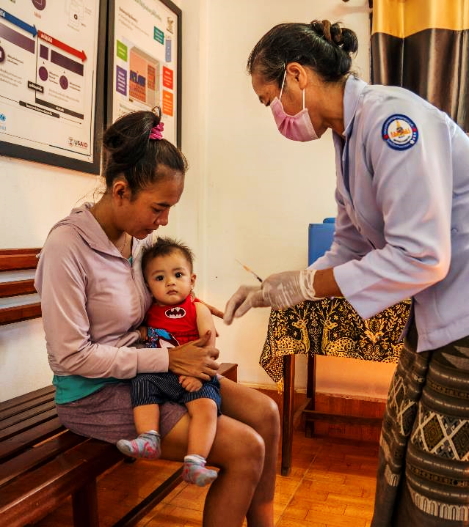
AGENDA
Welcome & Gavi’s Vision for CSOs in Health Systems
Gavi CSO Spotlights
CSO Dialogue
IV. 6.0 Strategy and Policy Briefing & Board Update

Slide 4
Welcome & Gavi’s Vision for CSOs in Health Systems
Kirsten Gagnaire, Facilitator & Bvudzai Magadzire, Gavi CSO Board Represntative

Slide 5



CSCE 2025 Webinar Series and CSO Consultations: a platform to listen, learn, and shape the future of CSO engagement
Insights directly from implementing CSOs
Webinar #2: Reaching Communities in Crisis: How CSOs Deliver Impact in Fragile Settings with Gavi Support
18 September
Webinar#3: Influencing Policy and Equity: How CSOs Strengthen Gavi’s Work Across the Health System
16 October
Informational and consultative
Gavi seeks candid feedback, concrete recommendations, and forward-looking collaboration

Slide 6




Today’s Webinar and Consultation Thematic Focus How do we ensure CSOs are not only funded—but structurally embedded—in health systems to enhance long-term resilience?
Embedding CSOs into routine public health architecture, not parallel efforts
CSO roles in reaching zero-dose children as part of local PHC systems
Visibility and coordination of CSOs when working through indirect channels
Strengthening results monitoring and learning systems to reflect CSO-system contributions

Slide 7
Gavi’s vision for CSOs in building resilient health systems
CSOs are a core part of national health systems, not parallel actors
They reach zero-dose children and missed communities in hard-to-reach settings
They support vaccine delivery, build trust, and drive community engagement
CSOs promote equity, amplify community voice, and strengthen accountability
They help build local capacity and support sustainable, country-owned systems

Slide 8
CSO Spotlights:
ALIMA
Red Cross SL
CCRDA

Slide 9



The Alliance for International Medical Action ALIMA Mauritanie
P r é s e n t a t e u r : D r W e n d w a o g a R . H . I L B O U D O
1

Slide 10






Assistance au PEV pour étendre la couverture vaccinale aux enfants «zéro dose» et les communautés sous immunisées en Mauritanie, Soutien aux prestations de service de vaccination
(CDS3, TCA, BCU, HPV)
Aperçu
Description du projet
HEC, Gorgol, Brakna, Traza, Inchiri & NKT Sud
Objectif Général
Contribuer à la réduction de la morbidité et la mortalité liées aux MEV et incluant les EZD et SV, en renforçant le partenariat entre les acteurs locaux et communautaires afin d’améliorer la demande ainsi que la continuité des services de la vaccination
RIM
Mesure d'impact 1 : Etendre la CV à
80 % d’EZD et sous-immunisés
Contexte
Assistance Technique Appui systémique Renforcement de capacités Compagnonnage
Récurrence des épidémies de MVE
Une offre vaccinale insuffisante
Une forte présence d’enfants zéro dose (EZD) et de communautés sous- immunisées.
Afin de laisser personne de côté, la Mauritanie a place l’équité vaccinale au cœur de sa stratégie comme une priorité nationale.
Mesure d'impact 2 : CV à 95% Penta 3
$902 125 Dollars
Parties Prenantes
PEV Central, DRS, Services décentralisés, DS, CCM
Communautés, Leaders, Groupements (OBC, OSC), élus locaux
Structures éducatives
2023 – S1 2025

Slide 11


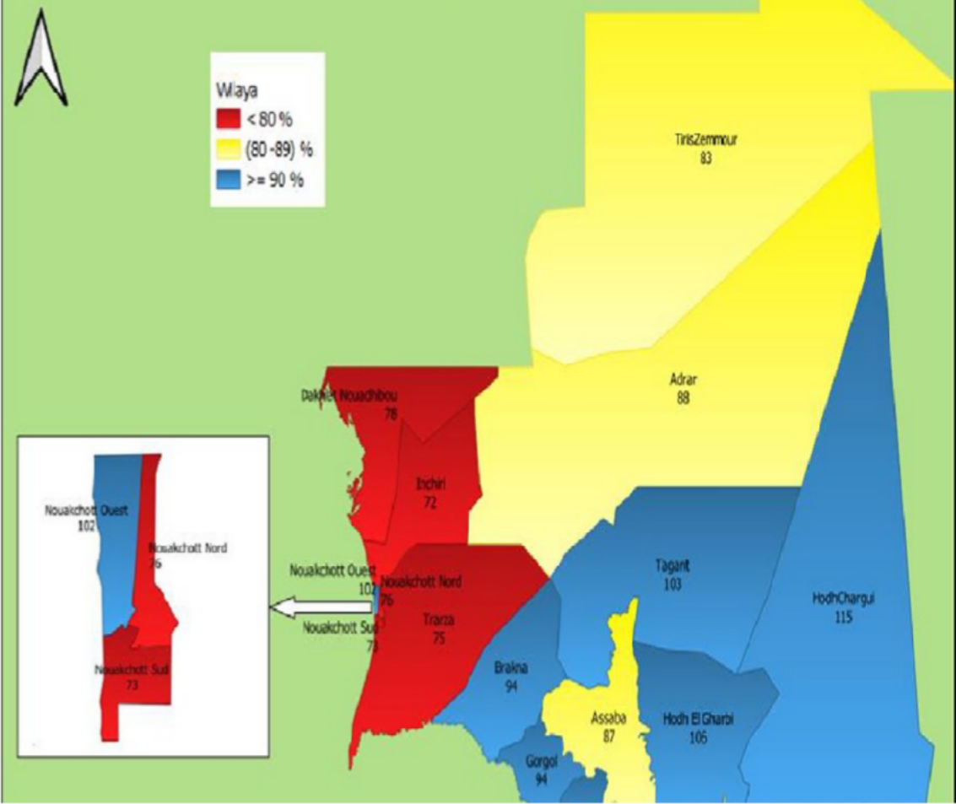
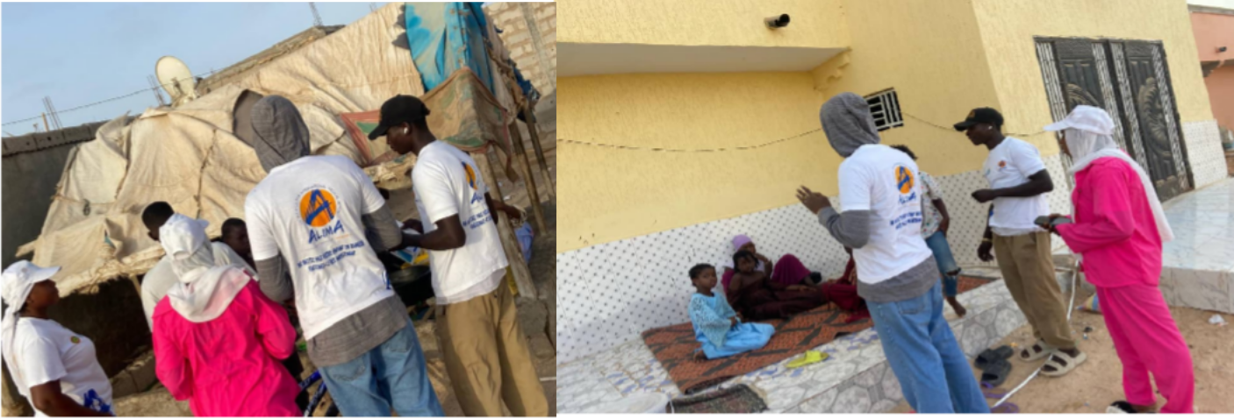
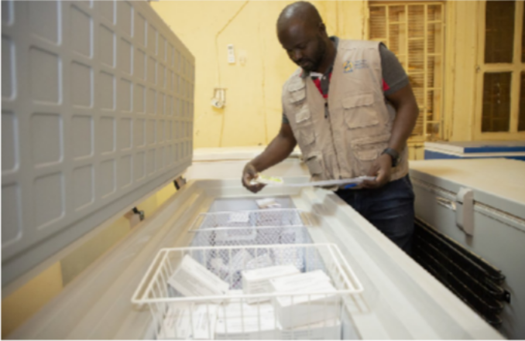
Sites d’intervention
Photos du terrain
Séance de sensibilisation sur la vaccination au profit des population des bidonvilles de NKT Sud par les RECOS. Juin 2025.
Séance de sensibilisation sur la vaccination de HPV au profit des filles de 9 ans à NKT Sud. Juin 2025
Appui de ALIMA à la gestion des vaccins dans la Brakna
Mapping des EZD
Depuis 2023, ALIMA déploie des interventions dans les zones à forte prévalence d’enfants "zéro dose".
Bassikounou ( HEC), Gorgol ( 5 Moughata) : Brakna, Traza, NKT Sud, Inchiri.

Slide 12



REALISATIONS
Formation :
2023: TCA 23 : 120 infirmiers formés à la vaccinologie.
2023 : CDS 3 : 100 Recos formés à la mobilisation Communautaire pour la vaccination.
2024 : TCA 24 : 100 Recos formés à la sensibilisation et à la mobilisation Communautaire pour la vaccination.
2024 - 2025: BCU : 60 Infirmiers chefs de postes formés à la vaccination.
2025 : TCA 25 : 10 Responsables OSC et 90 Recos formés à la sensibilisation et à la mobilisation Communautaire pour la vaccination.
2025 : GAVI OSC : 20 responsables de cooperatives feminines formées et 190 Recos à la sensibilisation et mobilisation Communautaire pour la vaccination.
2025 : GAVI HPV: 60 ICP formés, 60 Inspecteurs d’ enseignements et directeurs d’ écoles à la vaccination du HPV.
Gouvernance :
2023 - 2024 : (CDS3) Tenue des reunions de microplanification et de plaidoyer dans les écoles Superieures et les universités de NKTT sur la sensibilisation à la vaccination au profit des étudiants.
2024 : Implementation de strategies de communication sur les risques de la rougeole au niveau du HEC.
2025 : Révision de 24 Microplans de 24 Moughataas.
2023 - 2025 : Des supports didactiques et de communication élaborés.
Supervision :
2023 : 2 supervisions formatives réalisées dans le cadre du TCA 23.
2024 : 78 unites fixes de vaccination TCA 24 ont été supervisées.
2025 : 58 unités fixes de vaccination de 10 Moughataas de Trarza et de NKT Sud ont été supervisées dans le cadre du TCA 25.
–
Vaccination :
2023-2024 : 33 AVI ont été réalisées dans zones à faible couverture dans le cadre du CDS 3 et TCA 24.
2024-2025 : Appui de la DRS à la riposte contre l’ épidémio de rougéole.

Slide 13


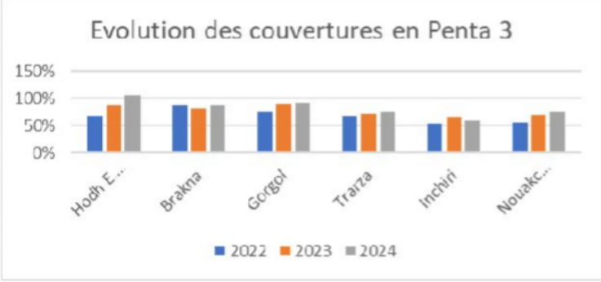

Victoires et succès du projet
Principaux défis à relever
Recommandation à différents niveau
1
Forte mobilisation communautaire (Approche GASPA, OBC + CM) → accès élargi aux enfants vivants dans des zones isolées ou marginalisées
1
Faible compténce (Structuration);
des
OBC
1
Au niveau de GAVI :
Accroite les allocations budgetaires conséquentes pour les projets futurs
2
Retard dans la mise en œuvre des activités conjointes (ALIMA & DRS, CCM);
Elargir à d’autres thématiques à haut impact
2
Evoluntiuon des couvertures de Penta 3
L’ancrage communautaire à travers les OSC et la participation active des relais locaux doit être renforcé.
3
Personnel de impliqué dans vaccination;
santé des CS peu les activités de
Prime de motivation jugée insuffisant 2
par les acteurs;
Au niveau des CCM & DRS :
Prioriser les activités conjointes planifiées avec le partenaires pour son exécution dans les délais;
4
Amélioration entre 2022 et 2024 : Stimulation de la demande par une forte mobilisation communautaire
Mise en oeuvre des Cliniques Mobiles dans le HEC
3
5
Insuffisance de ressources financières.
Prise en compte des données des AVI dans le cacul des couvertures vaccinales (DHIS2).

Slide 14

« Les Mauritaniens sont tellement accueillants qu’ils n’hésitent pas à dénuder un bras ou une jambe d’un enfant pour qu’il reçoive un vaccin, à condition que quelqu’un fasse l’effort de venir jusqu’à eux. »
MERCI
6

Slide 15



SIERRA LEONE RED CROSS SOCIETY
P r e s e n t e r : S t e v e n A b d u l N a b i e u P r o j e c t C o o r d i n a t o r
1

Slide 16






SLRCS– contribute to the reduction of the number of zero-dose children in collaboration with community actors in Five Districts in Sierra Leone
Overview
Project Description
Intervention area: Community Level
Location: Sierra Leone
Investment amount:
$ 630,253.46
Project duration: Sept 2024–
Dec 2025
To improve the delivery of integrated and quality immunization services at all levels in Sierra Leone by end of 2025
Objective:
Impact metric 1:
1,891
Zero dose children identified
Impact metric 2:
1,891
Zero dose children vaccinated
SLRCS is working with local branches in five districts to support the identification and vaccination of zero-dose and under-immunized children.
This effort is community-driven, engaging
Community Health Workers (CHWs),
Red Cross community-based volunteers,
local leaders at the chiefdom, facility, and village levels.

Slide 17


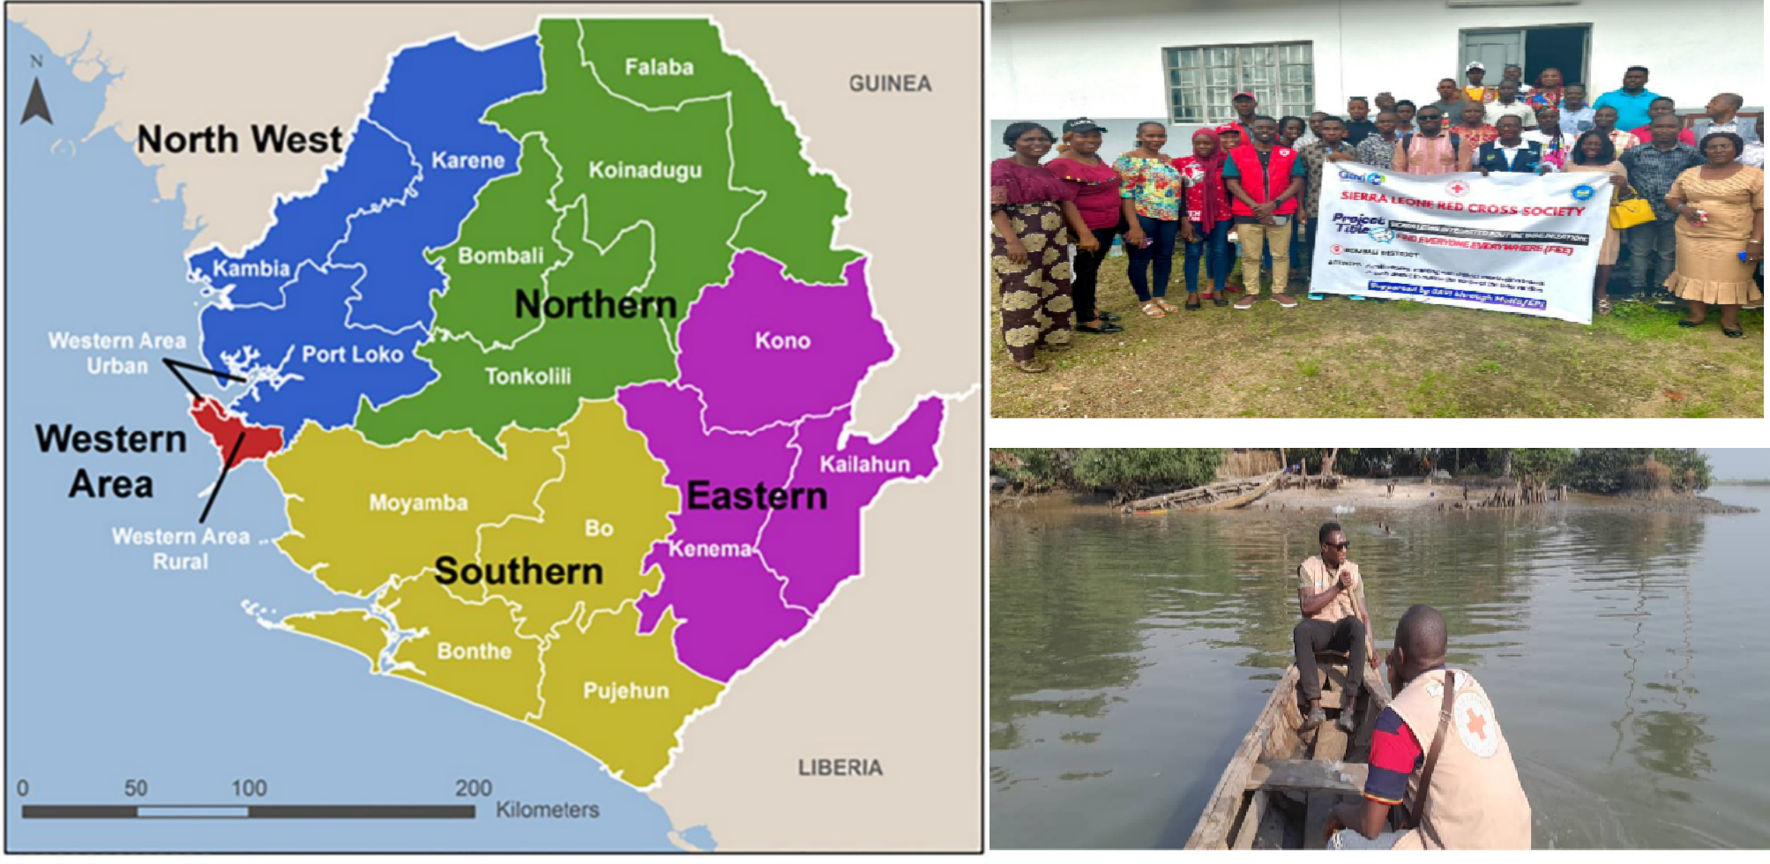
SLRCS– contribute to the reduction of the number of zero-dose children in collaboration with community actors in Five districts in Sierra Leone
Project locations
Field photos
Project is implemented in 5 districts, focusing on zero-dose and under-immunised communities in hard to reach communities
NB. Kambia, Port Loko, Karene, Bombali,& Tonkolili District

Slide 18

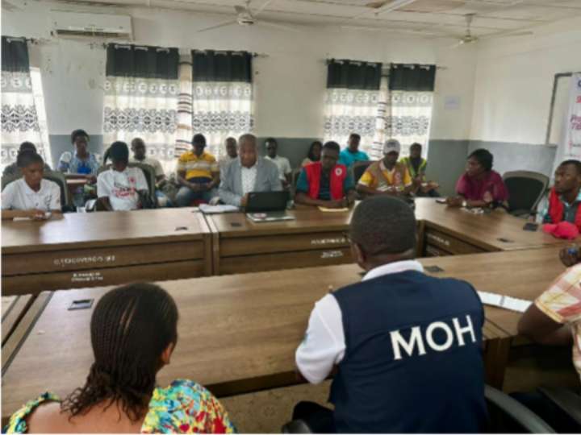
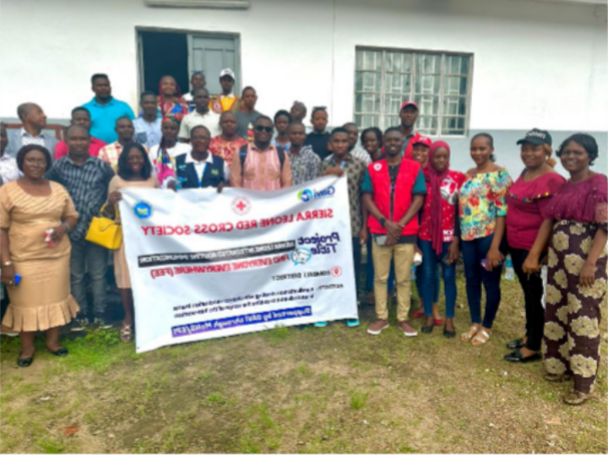
Role in Local Health Infrastructure
Focus areas Identification of Zero Dose and
under immunized children
Demand generation and vaccination in hard to reach communities
Stakeholders
PHC facilities, CHW, DHMTs, MoH, EPI teams, DHMT, Community Stakeholders
CSOs FOCUS 1000
Health for ALL Coalition
Local Leaders

Slide 19
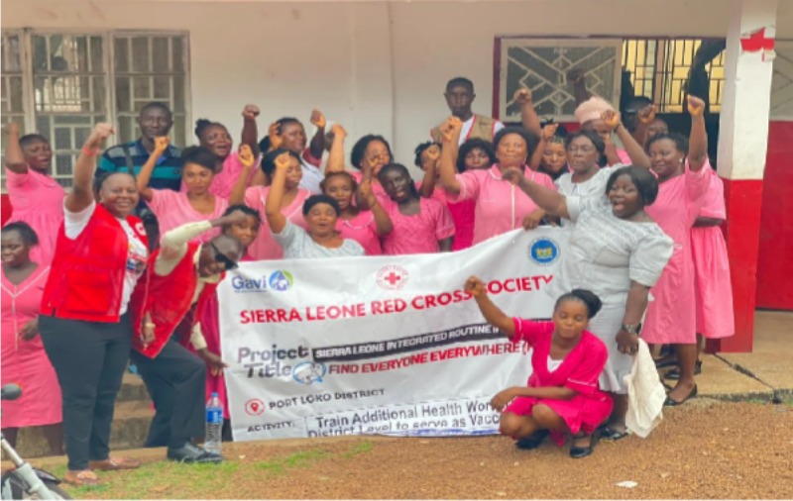
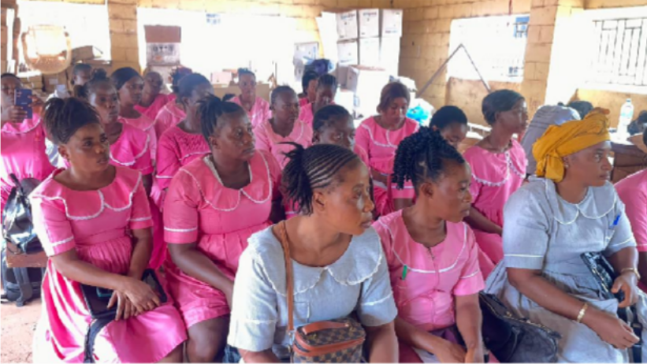
What We’ve Achieved: Strengthening Systems from the Ground Up
Key results:
Communities Visited
1342
Zero-dose children reached
PHC service uptake
Changes in immunisation coverage
Systems improvements:
Under Immunized Vaccinated
2711
Data collection and use
Health worker training or supervision
Zero Dose Vaccinated
1891

Slide 20


Outreach activities
Capacity Strengthening
Volunteers/ Mobilizers |  |  | 63
Journalists |  | 25
Stakeholders |  |  |  | 150
Health workers |  |  |  | 230
14212
12354
8192
7121
8123
7565
Penta 1
Penta 3 HPV COVID- Malaria 1 Malaria 3 19

Slide 21

SLRCS – contribute to the reduction of the number of zero-dose children in collaboration with community actors in Five Districts in Sierra Leone
Project wins and success
Key challenges faced
Recommendation to Gavi for 6.0
1
Strong partnership established with District Health Management Teams (DHMT) and Expanded Program on Immunization (EPI).
1
Reaching remote and hard-to- reach communities was physically challenging due to poor road networks and lack of motorbikes and boats hindered timely access.
1
Provide motorbikes, bicycles, or boats to outreach teams, especially in districts with difficult terrain.
Invest in digitalisation and supporting technologies, such as data collection tools, and solar powered cold chain equipment
2
2
Notable increase in routine immunization coverage in five project districts vaccinating 90% of zero-dose and under immunized children.
2
Insufficient cold chain equipment and vaccine supplies affected the smooth delivery of immunization services.
3
Continue and expand targeted CSO funding windows. Sustained, predictable, multi-year funding streams empower CSOs to plan and deliver long-term, community-rooted interventions.
4
Invest in continuous training, technical support, and resource provision to enable CSOs to effectively carry out outreach, data collection, and social mobilization.

Slide 22
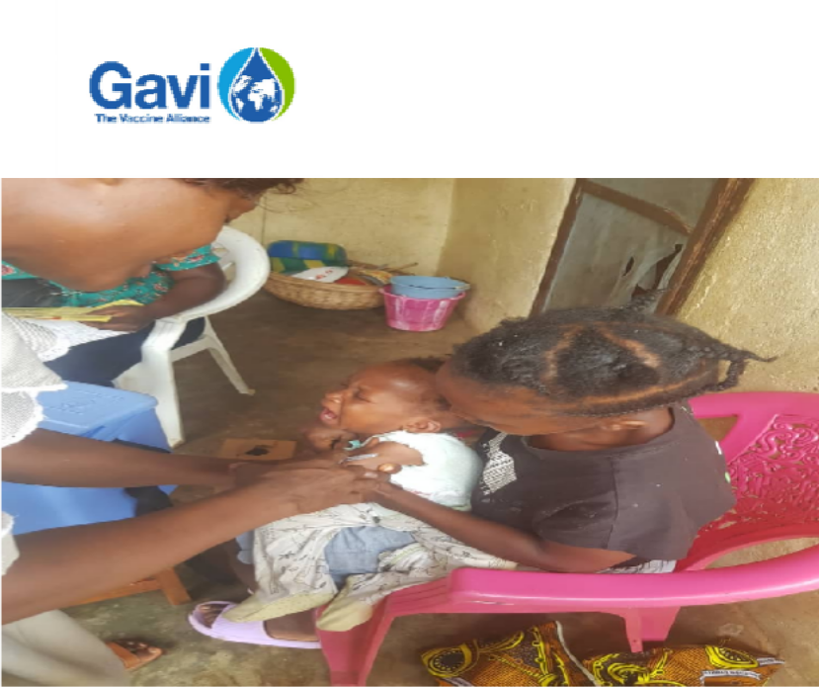

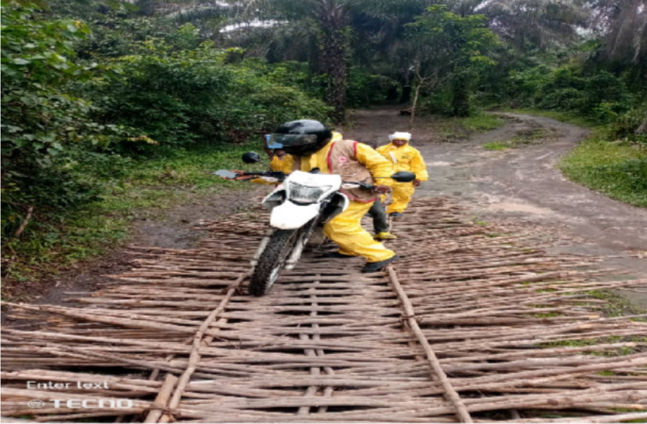
Thank you
Let’s strengthen and expand community-led outreach efforts to ensure no child is left behind in the fight against vaccine-preventable diseases.

Slide 23




Consortium of Christian Relief and Development Association (CCRDA), Ethiopia
P r e s e n t e r s : Legesse KidanNe & Asrat Asress
1

Slide 24


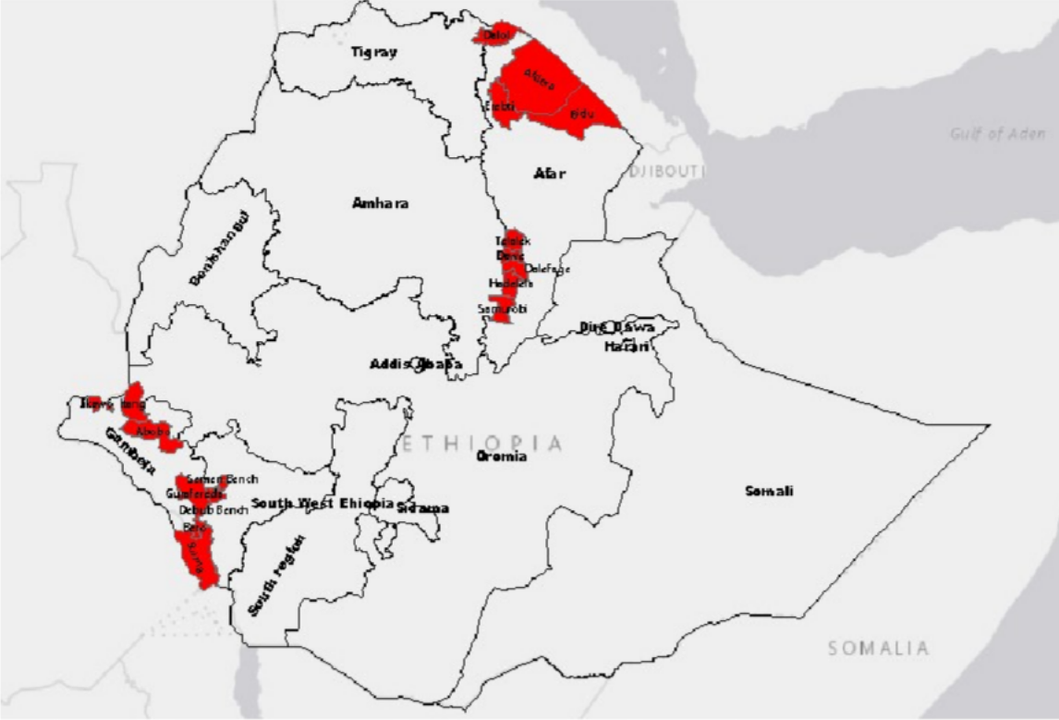
Reducing Zero dose and Under Immunized Children through Local CSOs in Hard to reach and pastoralist regions of Ethiopia
Project focus
Project Strategies
Targets
– ZDC = 39,434; UIC = 60,671
– SI = 32,417
– <5 Yrs = 148,623
Working within the Existing Health System
Partnering with MoH, RHB, and WoHO, PHCU and local CSOs.
Engaging in national planning forums Using RED/C micro-plans to ensure bottom-up.
Community Engagement
Active participation of religious leaders, volunteers, teachers, and kebele leaders.
Household-level engagement.
Data-Driven & Integrated Approach
Real-time data monitoring (ODK, Google sheet, DHIS2).
Joint supervision & reviews meetings with Health offices, and integrated service delivery

Slide 25
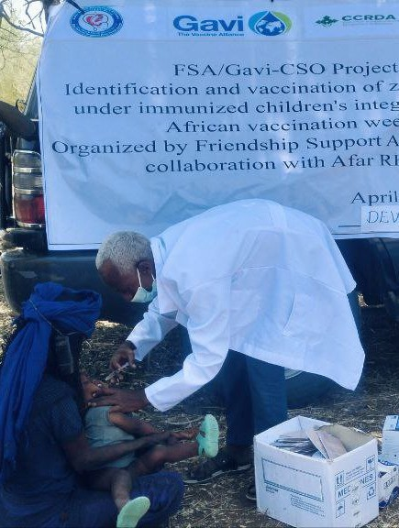
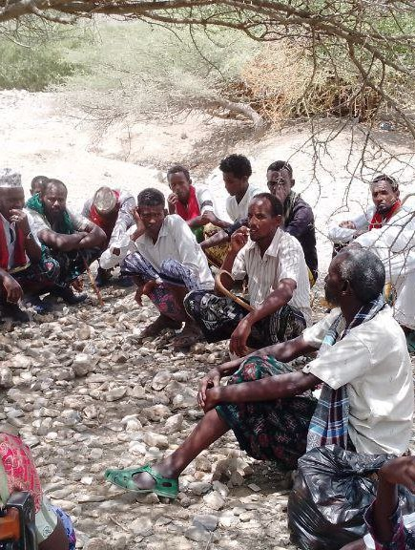
Reducing Zero dose and Under Immunized Children through Local CSOs in Hard to reach and pastoralist regions of Ethiopia
Community Engagement
342 people trained: 270 community volunteers, 45 kebele
leaders, 27 religious/school leaders.
Kebele Prioritization: 90 high ZD kebeles identified by woreda health offices, HFs, Communities
Headcount & Vaccination
45,986 households visited, 30,978 <5 children registered.
11,311 zero-dose and 12,488 under-vaccinated.
Cold Chain and Logistic Support
129 refrigerators assessed; 56 repaired; 6 facilities resumed static vaccination sessions.
25 vehicles and 5,112 reporting formats provided; 34 technical staff deployed
PIRI Services
24 PIRI sessions conducted; 933 ZD and 2,210 under- immunized children reached.

Slide 26
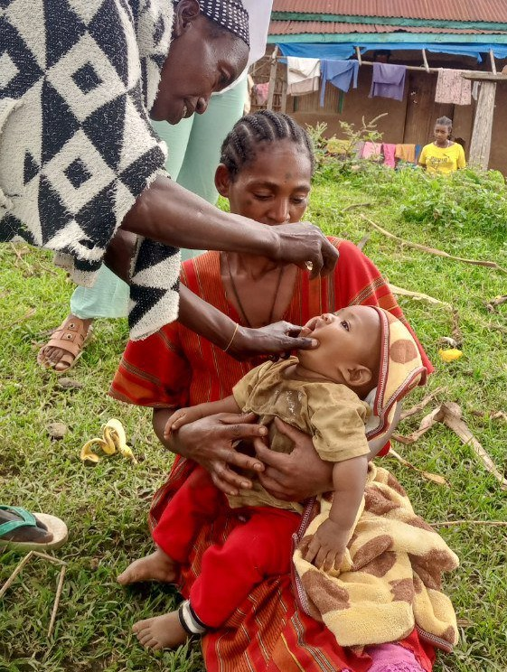
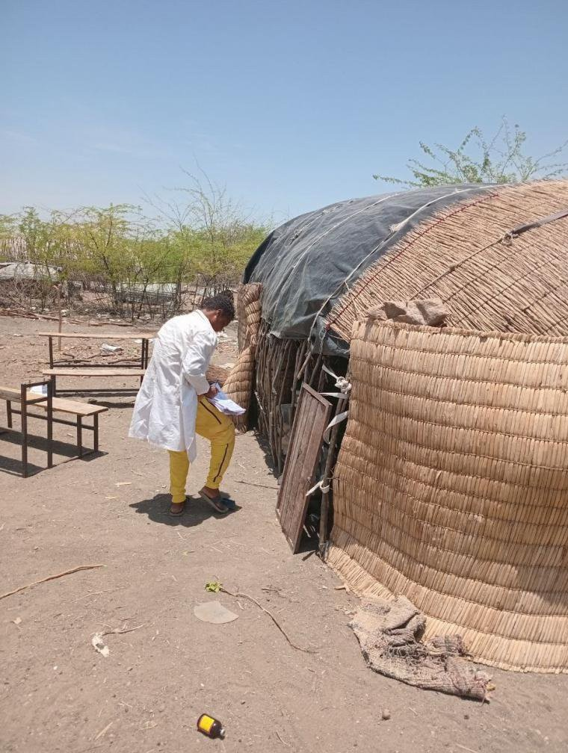
Reducing Zero dose and Under Immunized Children through Local CSOs in Hard to reach and pastoralist regions of Ethiopia
Microplanning
18 woredas developed RED/C micro-plans.
548 stakeholders oriented (health workers, volunteers, community leaders).
Children Reached
26,681 ZD (68% of target), 28,699 under-vaccinated
(47%).
System Strengthening
Community engagement enhanced for improved immunization service uptake and coverage,
Regular EPI performance review, feedback &follow up
36 HCs and 41 HPs have been proving services compared with their previous performance
EPI data quality and use improved

Slide 27
Reducing Zero dose and Under Immunized Children through Local CSOs in Hard to reach and pastoralist regions of Ethiopia
Key challenges faced
Recommendation to Gavi for 6.0
Low immunization coverage in remote kebeles:
RED microp anning, PIRI, outreach.
Data quality gaps: Utilized real time reporting tools (Google sheets, DHIS2).
Scale/Retain
Strong community engagement such as volunteers, and religious/clan leaders.
Integrated outreach for hard-to-reach/mobile populations.
Skill gaps of service providers: On-site training and mentoring.
HEW absenteeism: Motivational strategies to improve their performance.
Improve
Government - CSO coordination collaboration.
Local resource mobilization for sustainable EPI service delivery.
Utilize real-time data for action.
Cold chain failures: Facilitated refrigerator inventory and repair.

Slide 28
Thank you!

Slide 29
CSO Dialogue

Slide 30
Gavi 6.0 Strategy Briefing + CSO Board Update

Slide 31

Gavi Leap
Transforming through simplicity, transparency and synergy
Changes are required to roll out 6.0
Enables reform of Gavi in a new era
Principles are a blueprint for a wider global health leap
Country centricity
Country sovereignty
Focused mandates
Finite lifespans

Slide 32

The Gavi 6.0 strategy defines priorities for Gavi’s support to countries
Leaving no one behind with immunisation
VISION
To save lives and protect people’s health by increasing equitable and sustainable use of vaccines
MISSION
Country-led, sustainable
Community-owned, inclusive
Zero-dose and missed communities, first priority
Gender-focused
Differentiated, fragile-responsive
Integrated
Adaptive, resilient
Climate-sensitive
Innovative
Collaborative, accountable
PRINCIPLES
1
2
3
4
INTRODUCE AND SCALE UP VACCINES
STRENGTHEN HEALTH SYSTEMS TO INCREASE EQUITY IN IMMUNISATION
IMPROVE PROGRAMMATIC AND FINANCIAL SUSTAINABILITY OF IMMUNISATION PROGRAMMES
ENSURE HEALTHY MARKETS FOR VACCINES AND RELATED PRODUCTS
GOALS
GOALS
GOALS
Long-term predictable funding
One Alliance
Global political commitment
Simple, efficient and agile Gavi operating model
Digitalisation, improved data and evidence
Collaboration with private sector and development finance institutions
ENABLERS

Slide 33





New Health Systems Strategy defines five key shifts aligned with the Gavi Leap
Shift | Description
Differentiated approach | Differentiated investments to drive programmatic sustainability
Consolidated planning & funding | Consolidation of HS programming across immunisation delivery activities, including vaccination campaigns
Catalysing innovation | More deliberate approach to catalyse innovation at country level; focus on addressing persistent challenges
Strengthened partnerships | Enhanced partnerships to enable primary health care (PHC) approach in line with Lusaka Agenda
Intentional measurement | Strengthened monitoring and measurement of HS programming, prioritising country needs and enhancing peer-to-peer learning

Slide 34




Moving towards a consolidated and aligned Gavi funding architecture makes it easier for countries to work with Gavi
Consolidated and aligned Gavi funding architecture
`
Single cash grant through holistic application for Gavi Support:
NIS route or non-NIS route
Fixed country grant cycles
Countries can choose a grant cycle with first disbursement within a flexible two-year window
Reshaping how countries engage with Gavi
Addressing current challenges:
Countries juggle processing efforts of multiple simultaneous grants
Current system that fosters disjointed programming
With the following benefits to countries:
Reduced transaction time spent on grant processing
More timely embedding of Gavi strategic shifts into grants

Slide 35



From 2026, countries will apply for support through one holistic five-year plan
In-kind
Cash to country
Previous levers
New levers
Vaccine support
Diagnostics
Vaccines & diagnostics In-kind vaccine support and diagnostics
Cash to countries Consolidated cash envelope to countries
Health system strengthening (HSS)
Equity Accelerator Fund (zero-dose)
Cold Chain Equipment Optimisation Platform (CCEOP)
Targeted Country Assistance (TCA)
Vaccine Introduction Grants (VIG)
CSO funding requirement: Board mandate to allocate >10% funding to civil society partners
Operational support for measles/measles-rubella follow-up vaccination campaigns
Switch grants
Innovation top-up
Minimum floor based on Alliance forecast of cold chain equipment needs
Other vaccination campaign operational support (to be allocated outside of country ceiling)
Guardrail for measles/measles-rubella follow-up vaccination campaigns

Slide 36
Partnerships approach for 6.0
 | Key shifts in 6.0
Country ownership | Rebalance towards country-centric and differentiated model
Differentiation | Align TA with Gavi 6.0 top priorities, based on country context, including deliberate focus on country capacity building where relevant
Context appropriate partnerships | Systematically leverage comparative strengths of core & other context appropriate partners
Focus on results | Move to a simplified but rigourous performance management process that focuses on learning and improving results
Funding model | Optimise partner support through a streamlined funding model
Partnerships Accountability Framework (PAF) | Mutual accountability aligned with roles and responsibilities, captured in a result-focused accountability framework
Principles
Levers

Slide 37
6.0 BUDGET RECALIBRATION
Gavi secured over US$9B for the 2026-2030 strategic period through replenishment efforts spanning over 18 months
Gavi Board was requested to adjust the 6.0 ambition by US$2.5 – 3B based on the replenishment outcome:
All previous Board decisions were eligible for review

Slide 38
KEY OUTCOMES RELEVANT FOR CSOs
Reductions across all Strategic Goal areas
Minimum 10% ringfencing for CSOs retained; to be applied to the consolidated cash grant
Fragile & Humanitarian support retained, with $150 million reduction in budget
Global/Regional Solutions Fund, previously SFA retained

Slide 39
OTHER APPROVALS FROM BOARD MEETING
First Gavi Health Systems Strategy
Secretariat led Exceptional Grant Extensions for country grant extension requests during the transition from Gavi 5.1 to 6.0
Governance Pathways for Next Generation Vaccines
Revised Health Systems and Immunisation Strengthening (HSIS) Policy as part of the Eligibility & Transition Policy
Opening of funding window for an emergency Mpox stockpile and for Respiratory Syncytial Virus (RSV)
Updated Fragile and Humanitarian (F&H) approach
Evolution of the Gavi Partnership Approach

Slide 40
Open Q&A
What will be different in how CSOs are engaged in 6.0?
Where are entry points for CSOs to shape policy and implementation going forward?
Please raise your hand or use the Zoom Q&A function to type your question
Qu'est-ce qui changera dans la façon dont les OSC seront impliquées dans la version 6.0 ?
Quels sont les points d'entrée pour que les OSC puissent façonner les politiques et leur mise en œuvre à l'avenir ?
Veuillez lever la main ou utiliser la fonction Q&R de Zoom pour taper votre question.

Slide 41
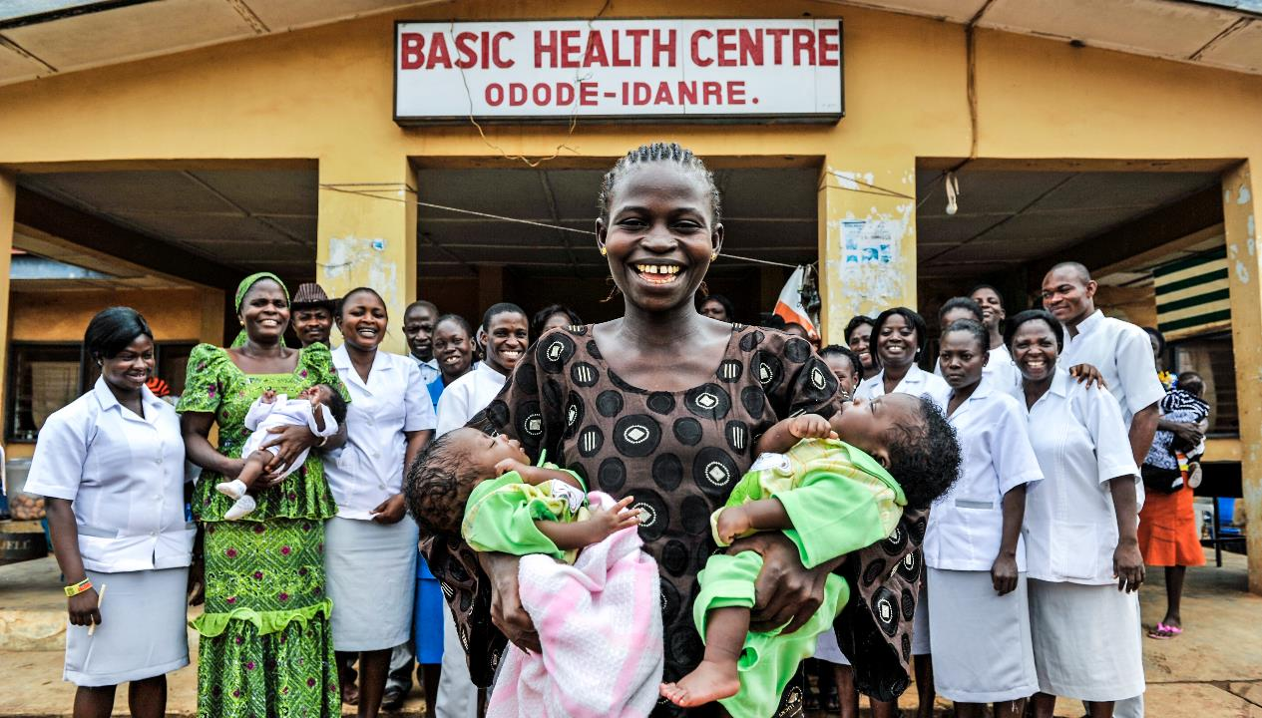
“A world in which civil society organisations are integral partners in a vibrant, strong social movement towards reaching countries' immunisation goals.”

